Slide 1
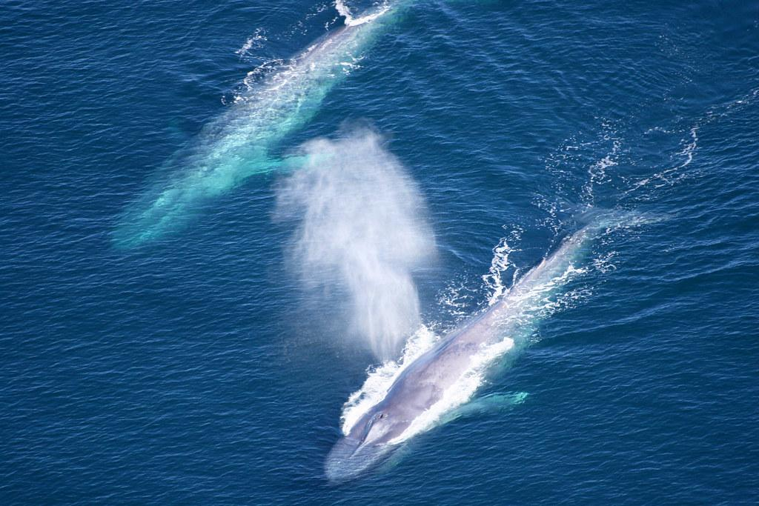
Low-frequency acoustic analysis in Nunatsiavut
500 Hz - 0 Hz

Slide 2
Identified calls
Upsweep (N Atl right, humpback, bowhead, sei)
Downsweep (Sei, Blue D)
Fin 20Hz
Fin 40Hz
Blue 9Hz
Minke pulse train
Banded (N Atl right, pinniped, bowhead)

Slide 3
Parameters:
LTSA:
Plot length: 1 hour
End Hz: 500 Hz
Brightness: 6 (adjust if necessary)
Contrast: 250 (adjust if necessary)
Spectrogram:
Plot length: 60 seconds
End Hz: 200 Hz
%Overlap: 90
FFT length: 1000
Same brightness/contrast as used for LTSA, minor adjustments okay.

Slide 4
Fin whale
40 Hz pulses:
Duration: ≤1 second
Downsweep ranging from 80 ~ 40Hz
20 Hz calls:
Duration: ≤1 second
Pulse ranging from 30 ~ 10Hz (can have varying bandwidth)
Their calls are loud, around 190dB
They repeat every 10-40s and can last for hours.

Slide 5
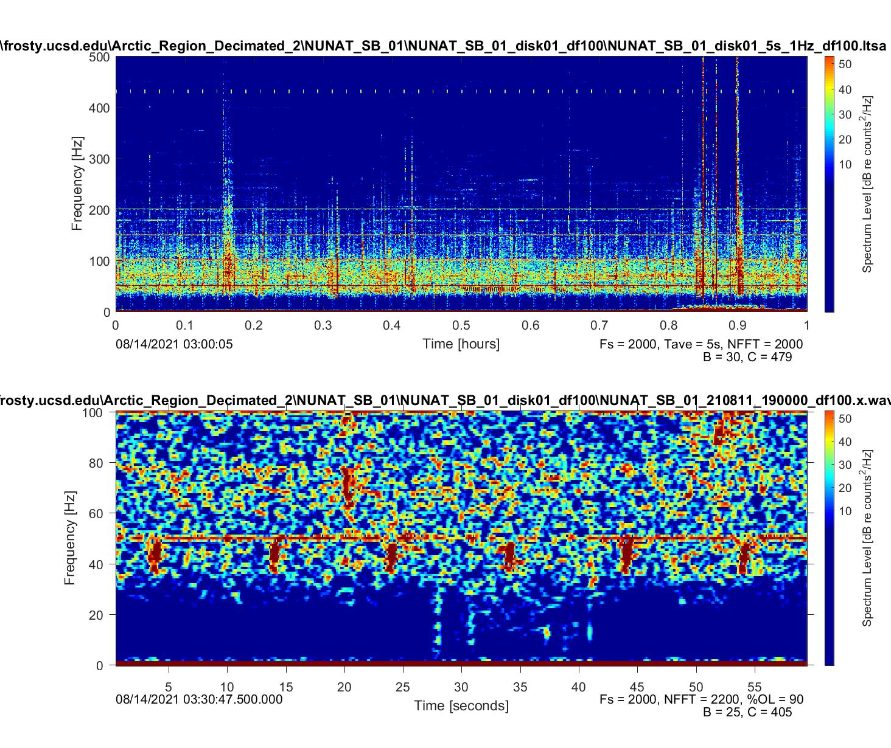
Fin whale
40 Hz call

Slide 6
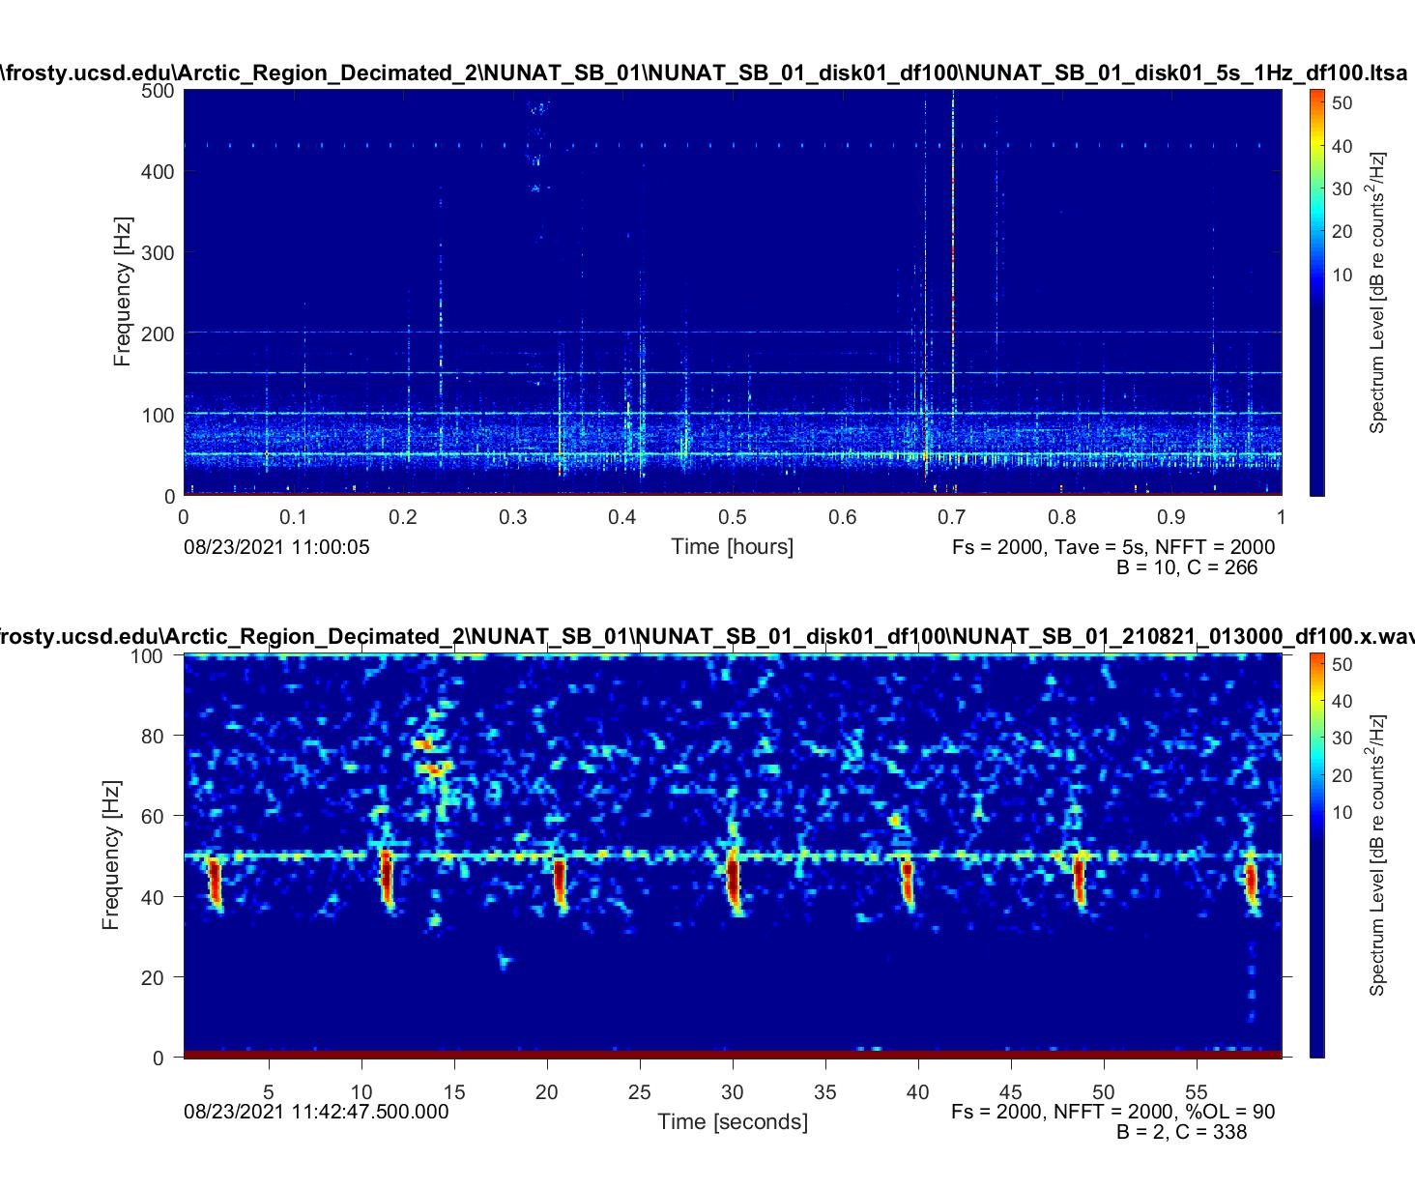

Slide 7
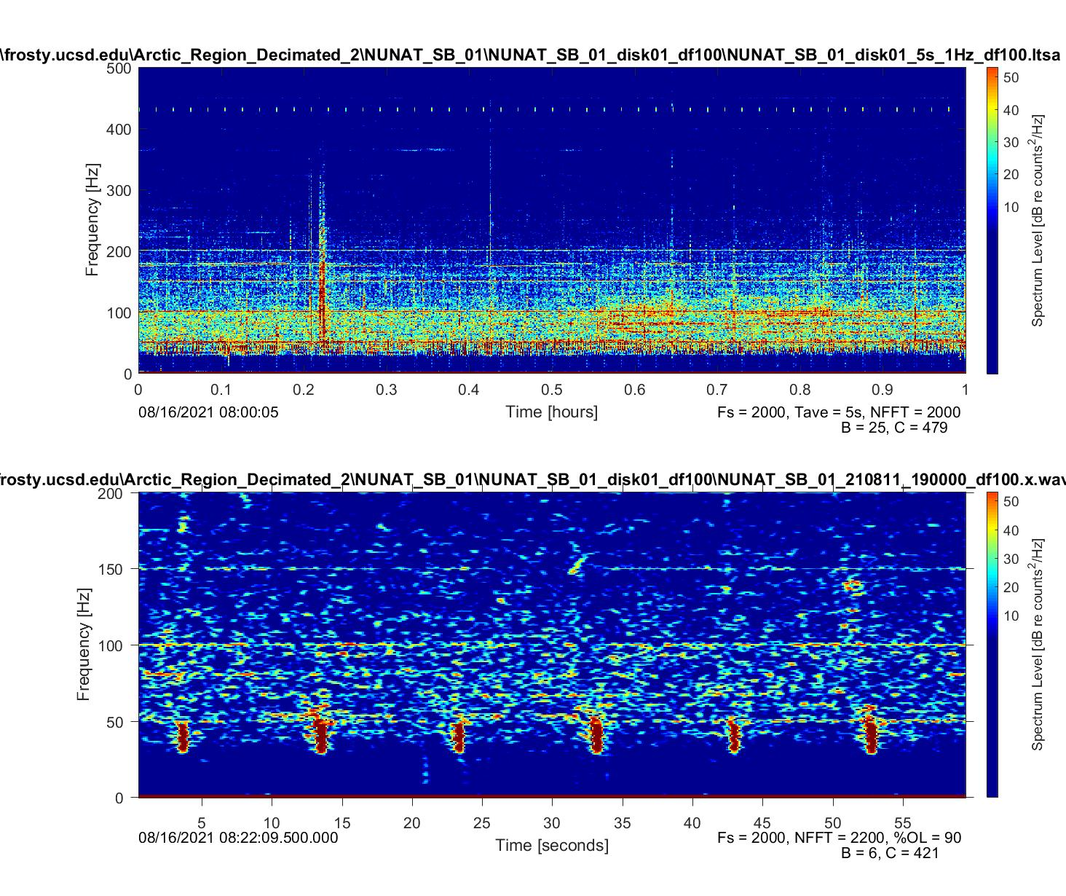

Slide 8
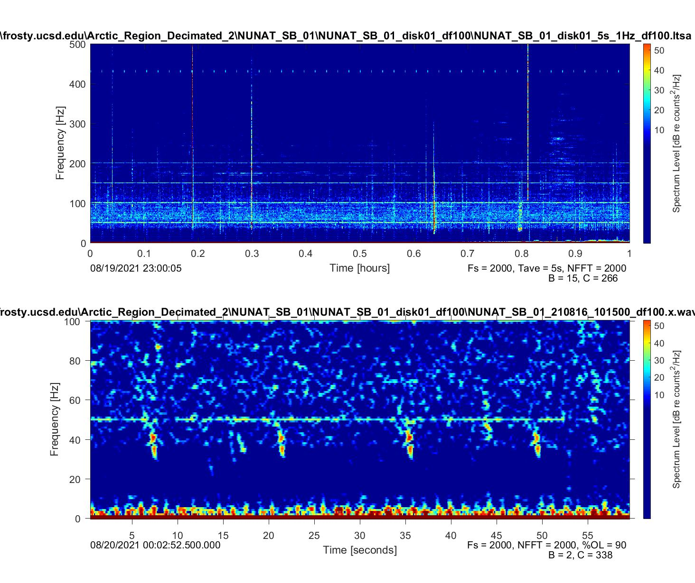

Slide 9
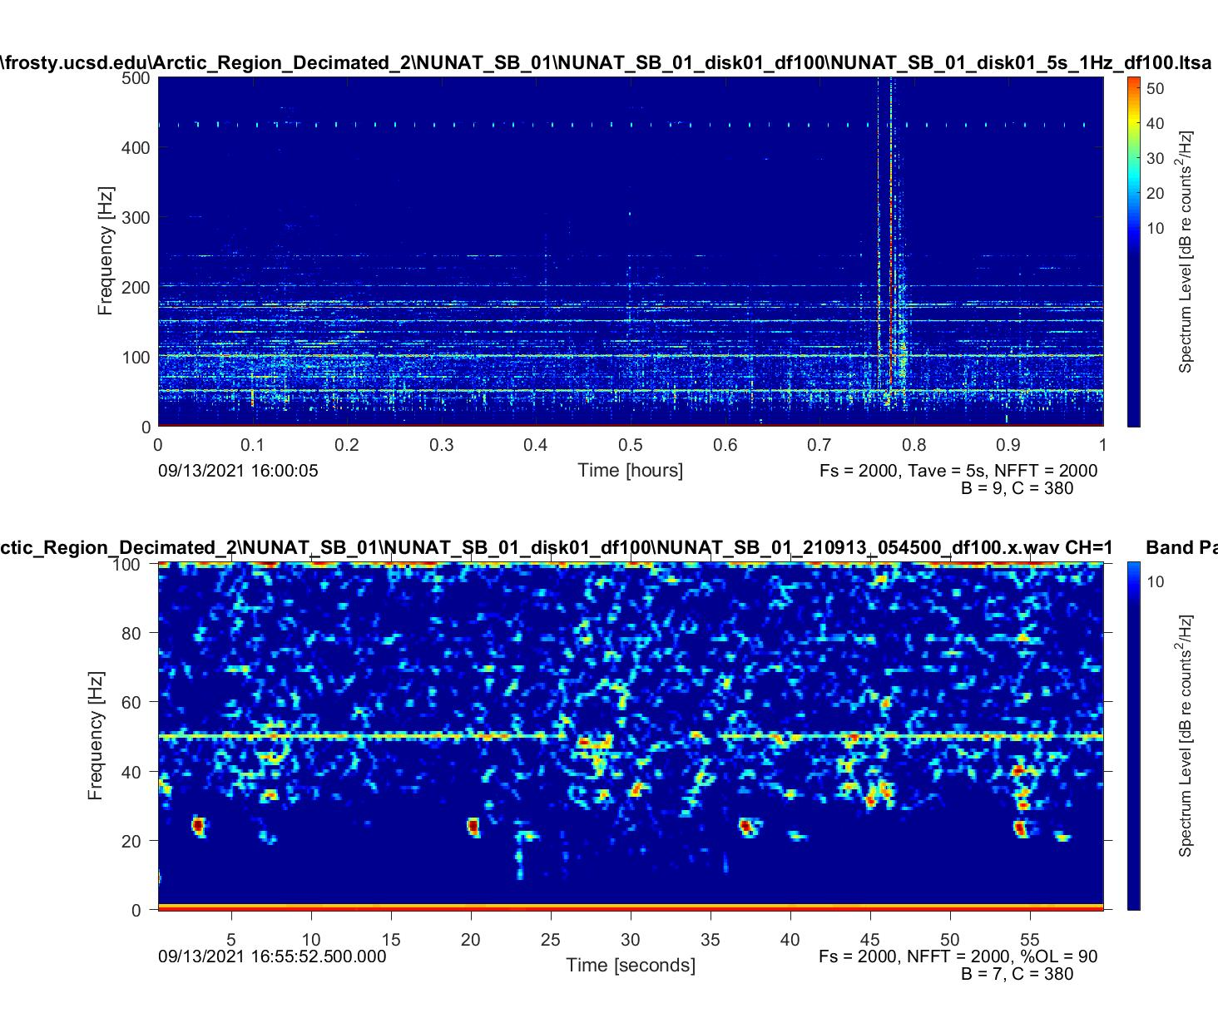
20 Hz pulse

Slide 10
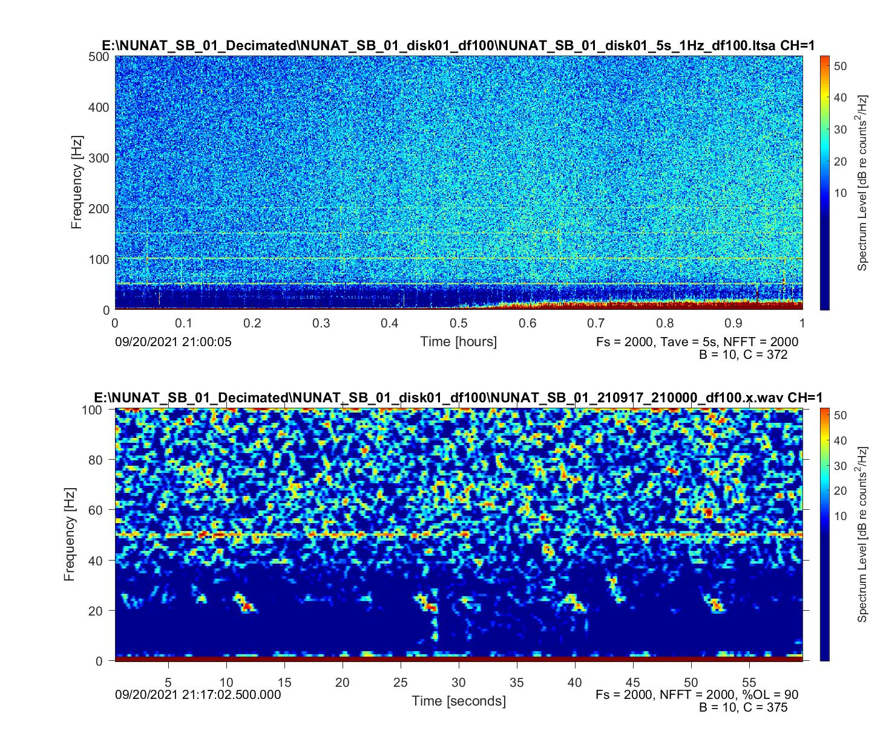

Slide 11
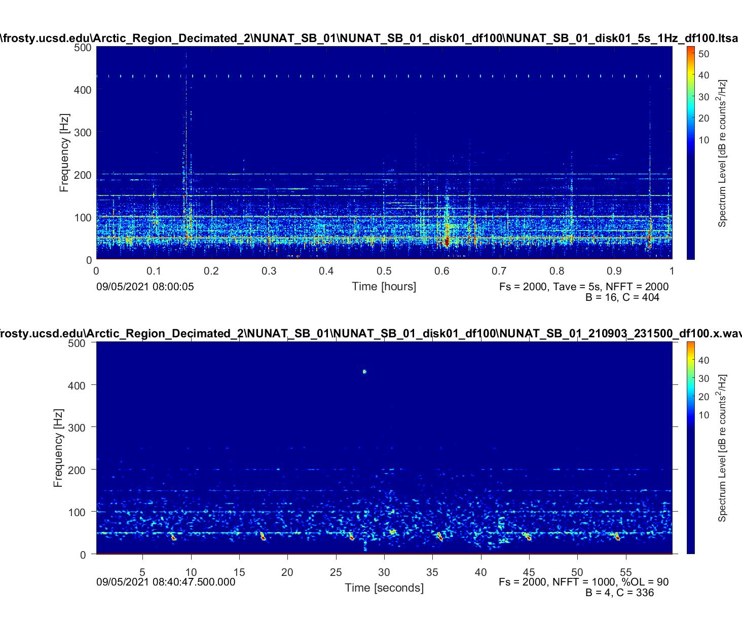

Slide 12
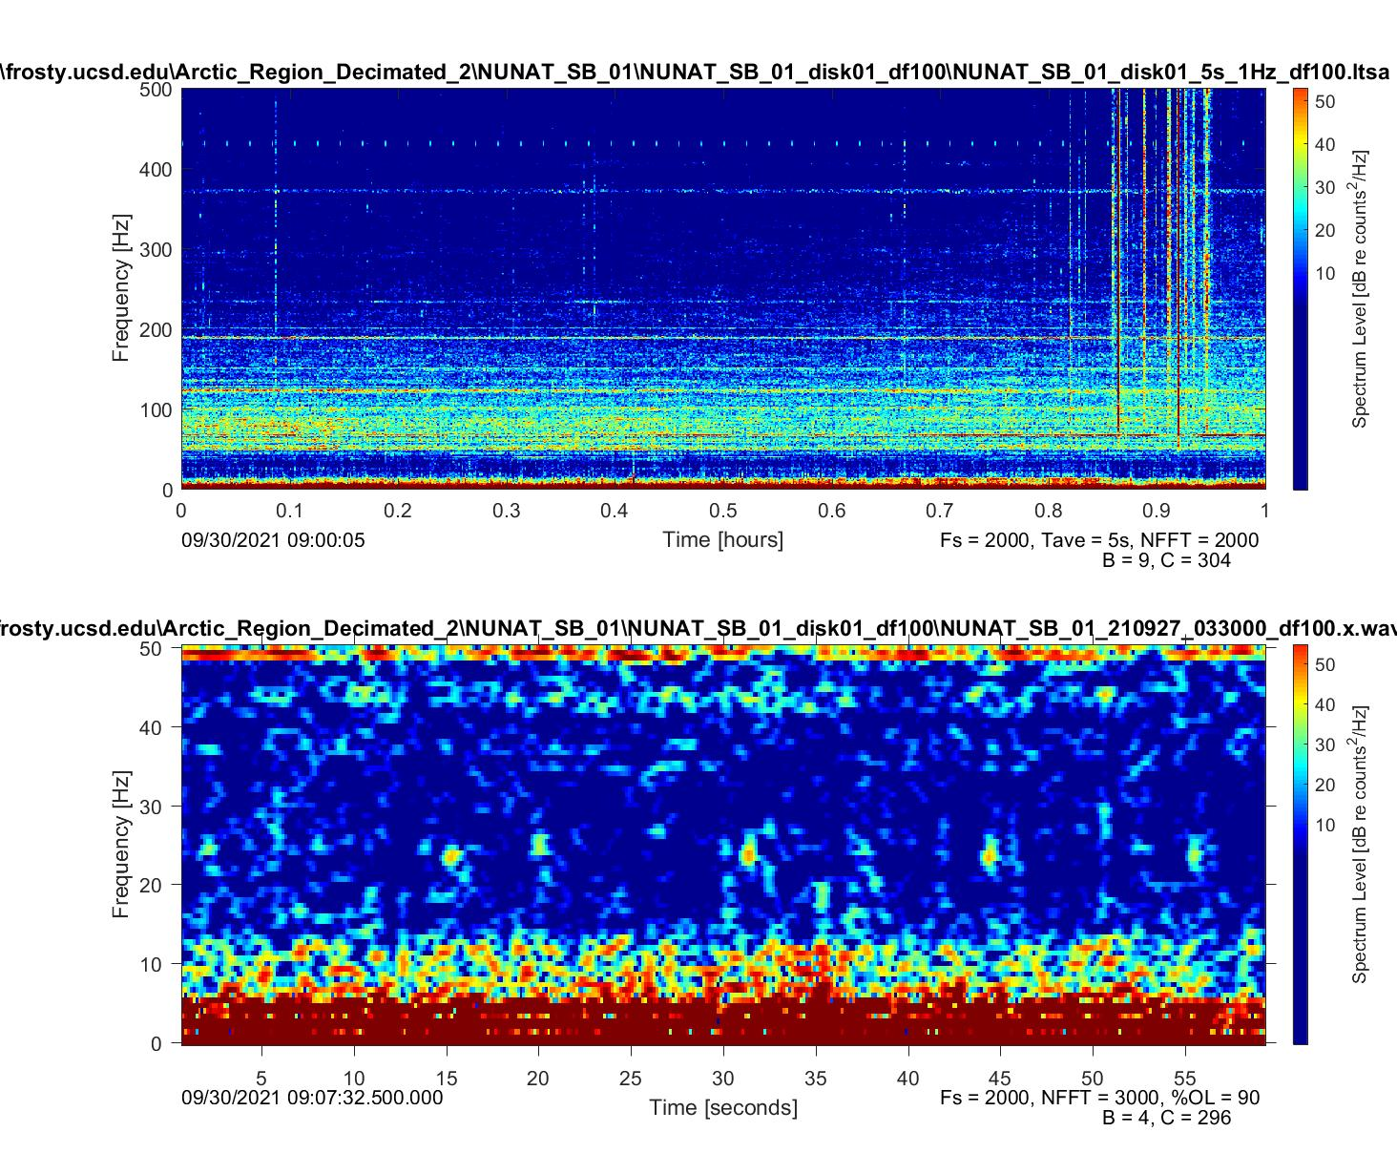

Slide 13
Sei whale
Downsweep calls:
Duration: 1-4s
Downsweep ranging from: 100Hz ~ 30Hz
Upsweep calls:
Duration: >1s
Upsweep pulses ranging: >500Hz

Slide 14
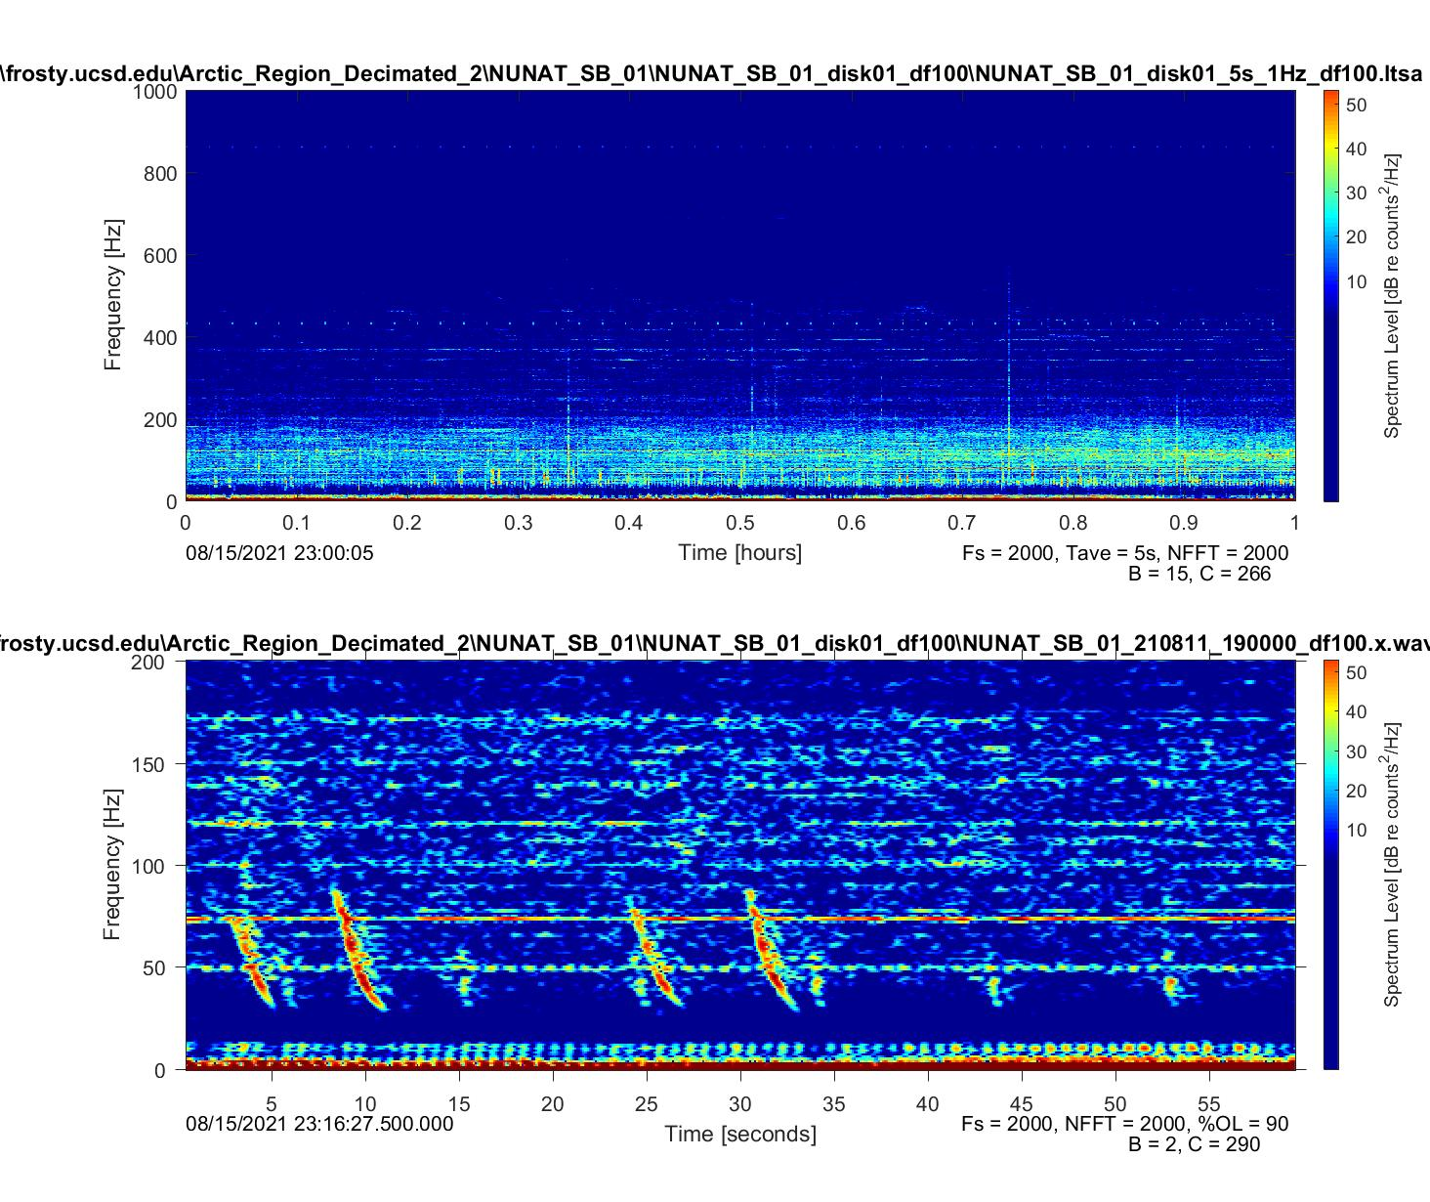
Downsweep ranges from 80 Hz to 30 Hz
Lasts about 3s

Slide 15
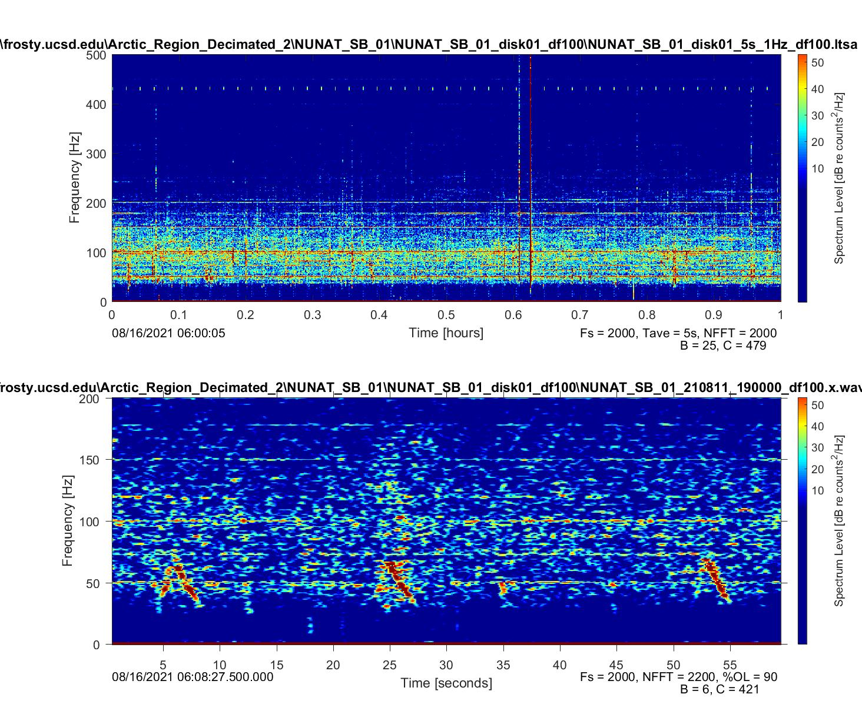

Slide 16
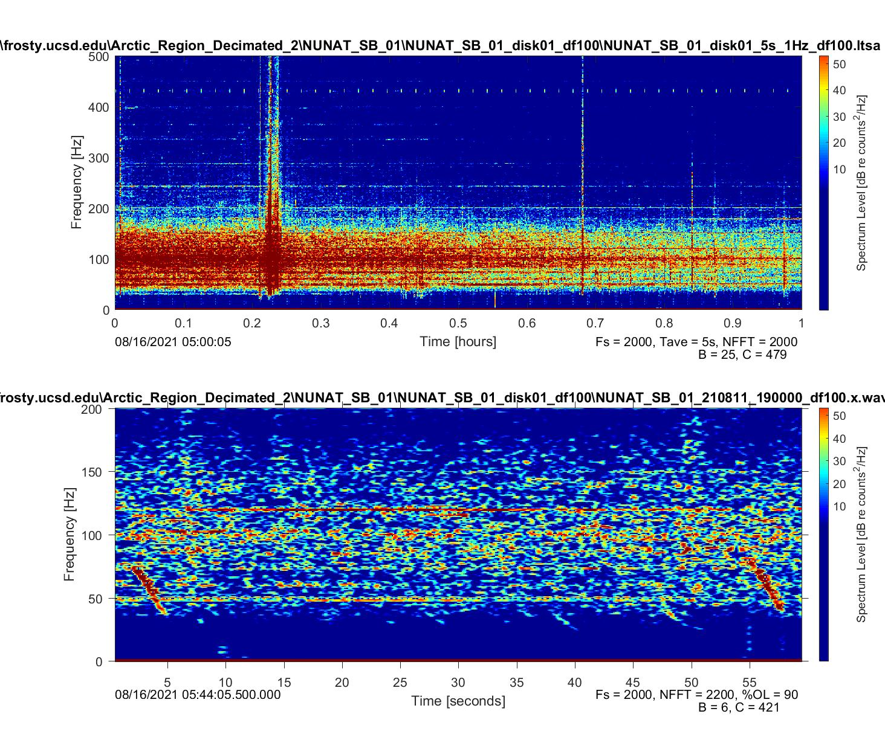

Slide 17
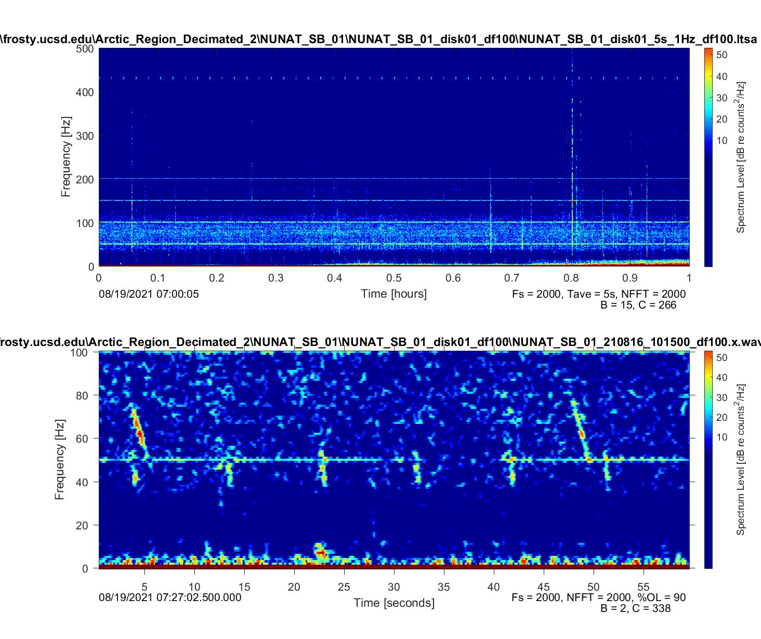

Slide 18
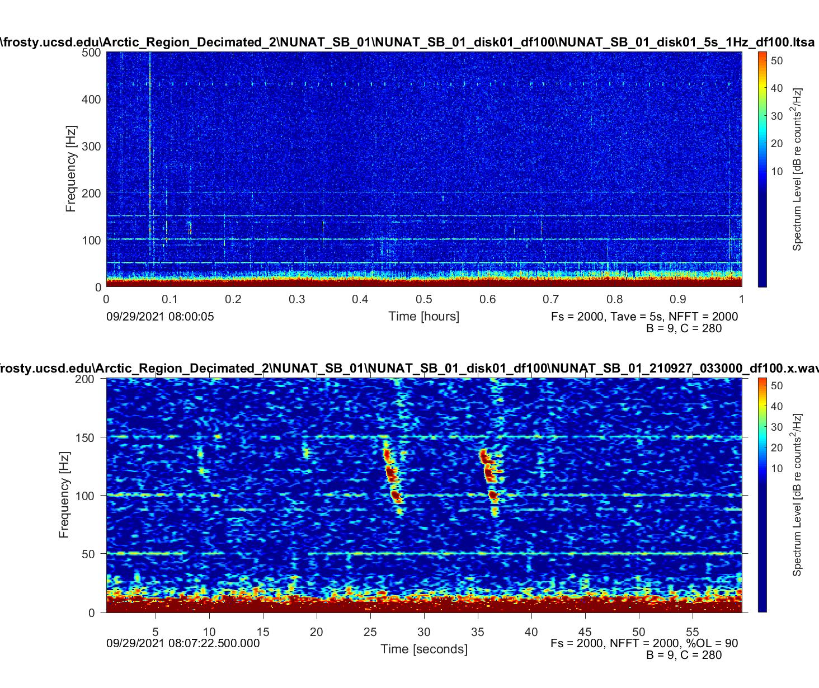

Slide 19
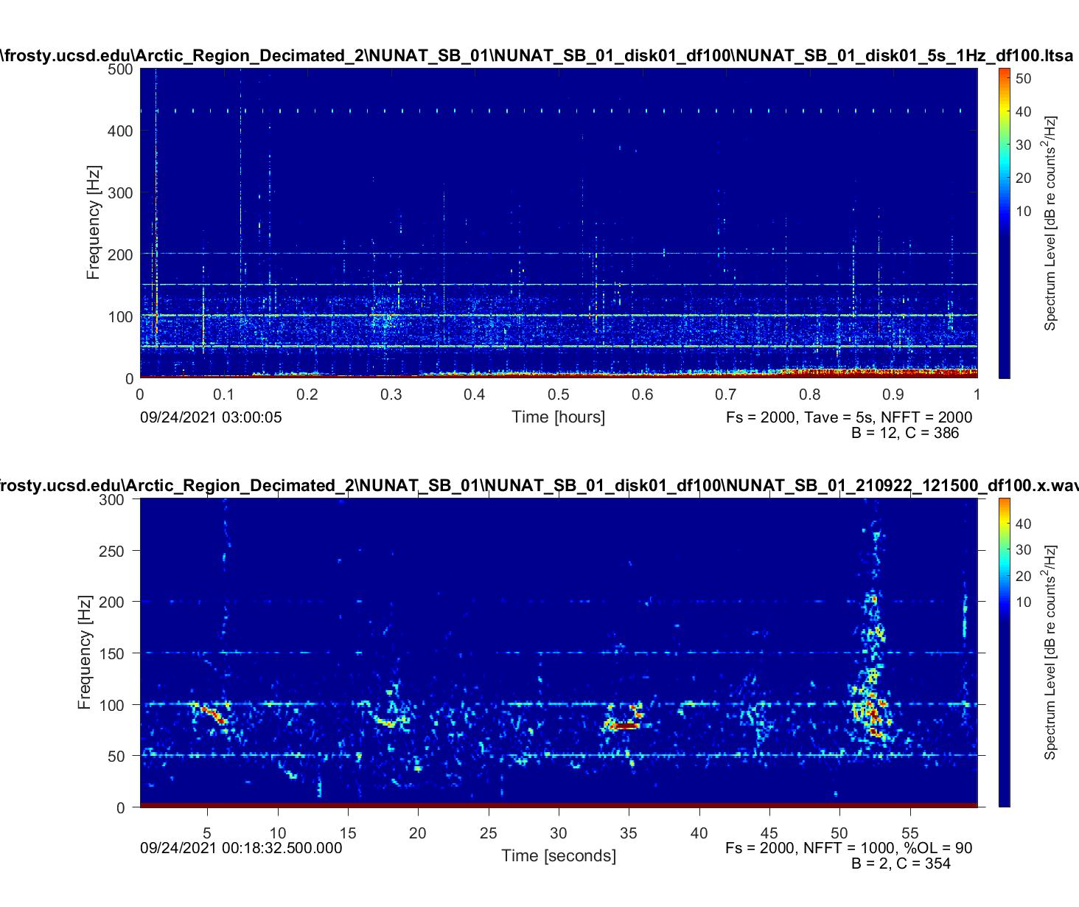
?

Slide 20
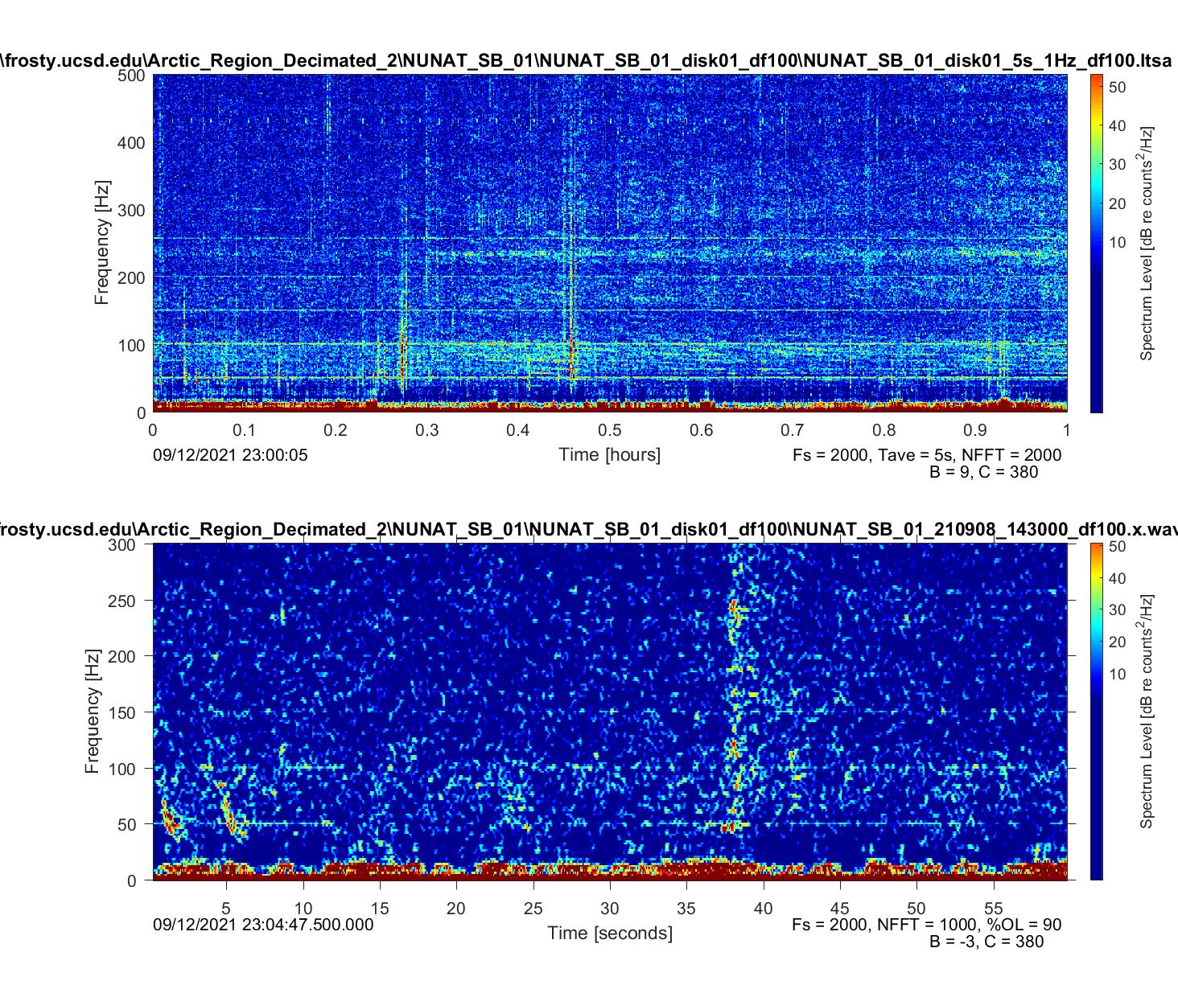

Slide 21
Minke whale
Pulse trains
Duration: 20 - 60 s
Peak frequency: 50 ~ 200 Hz
Pulse trains have fluctuating interpulse intervals

Slide 22
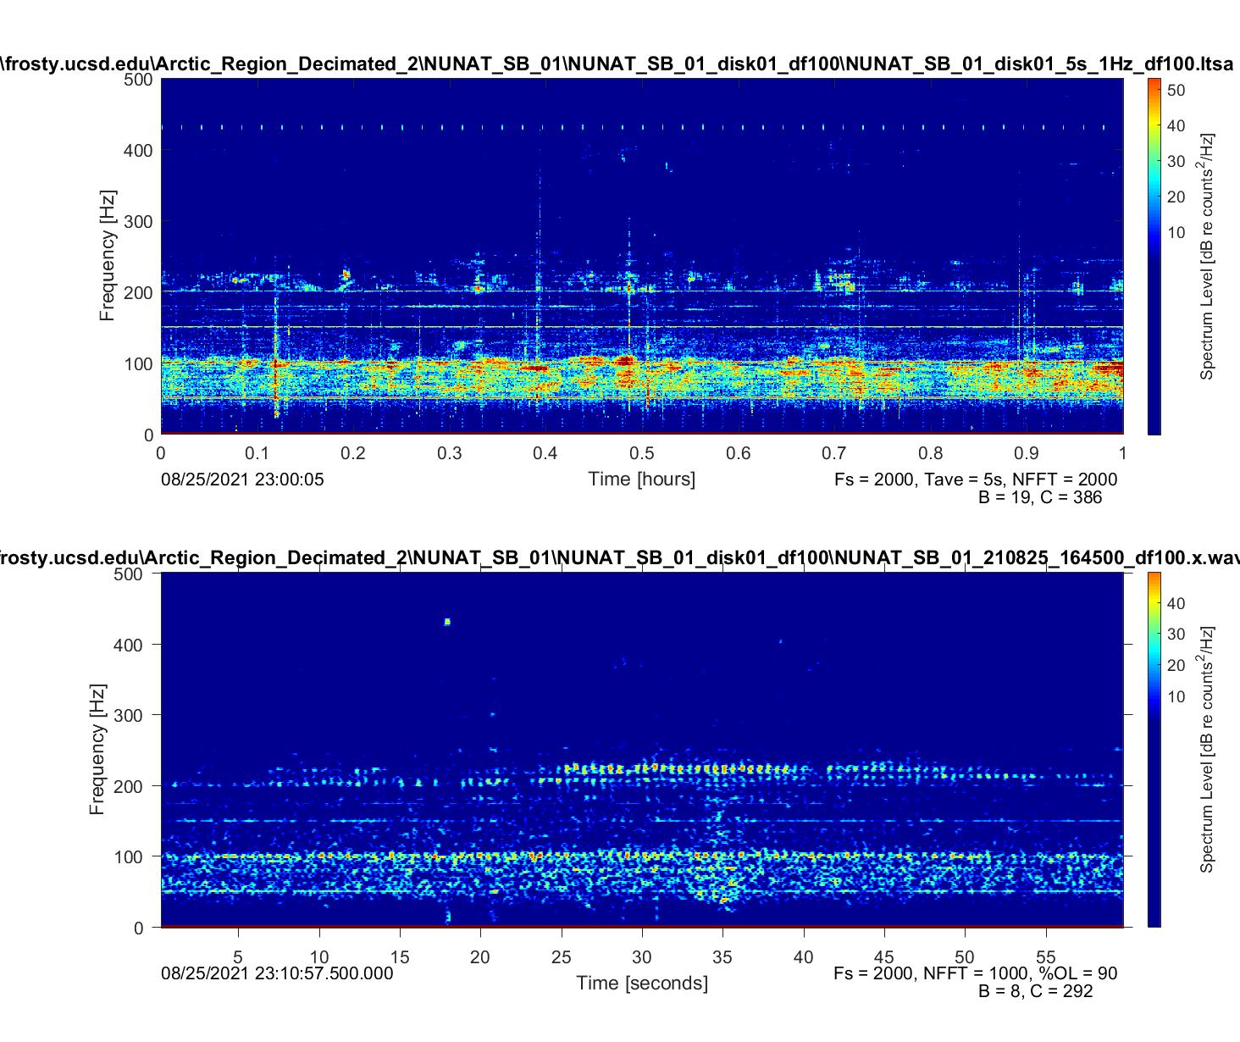

Slide 23
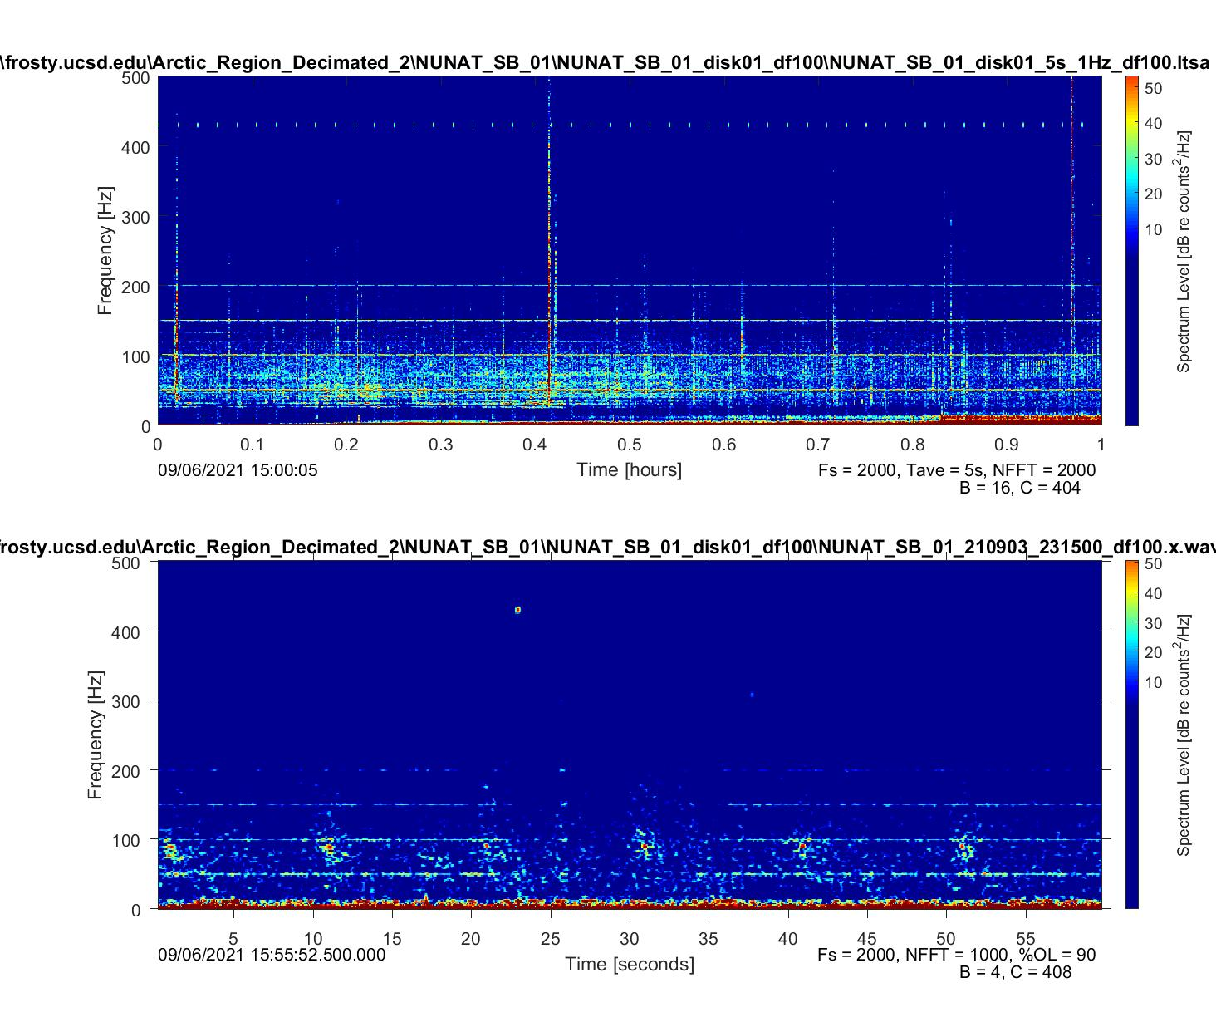

Slide 24
Bryde’s whale
Be 7
Duration: 1-2.5 s
Frequency: 44 Hz
About 2-4 harmonics visible
Pulse bout
Duration: 0.5-1 s
Pulse bouts vary in length from 2-15 pulses
Downsweep frequency: 80 ~ 120 Hz
Interpulse interval: 1 s

Slide 25
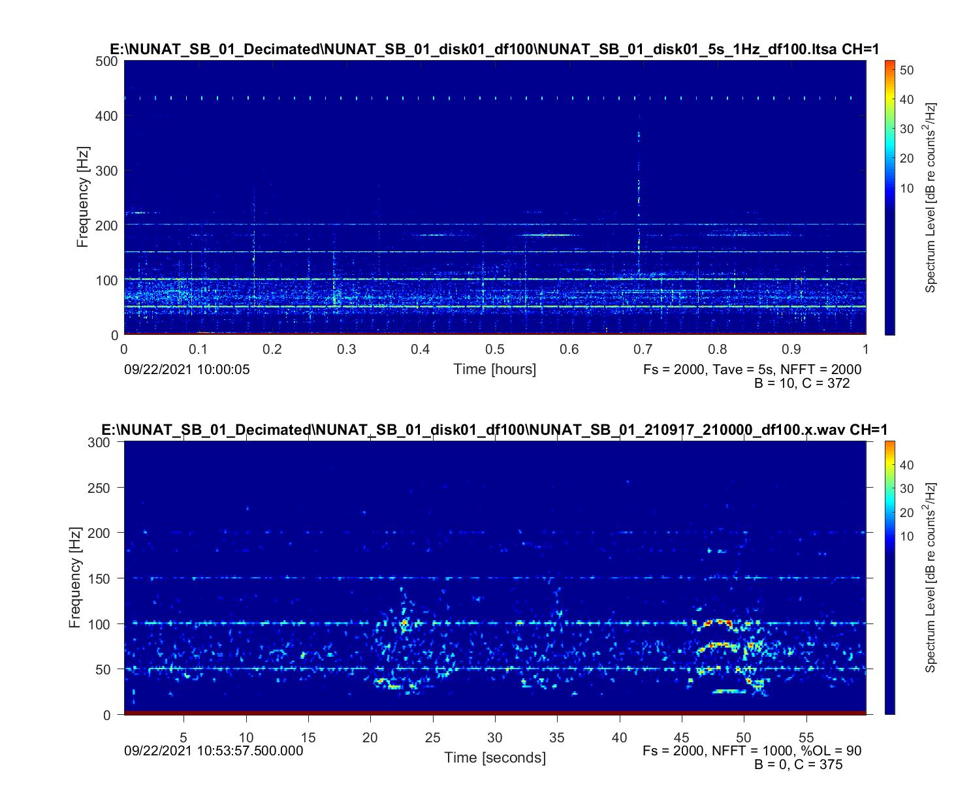
Be 7

Slide 27
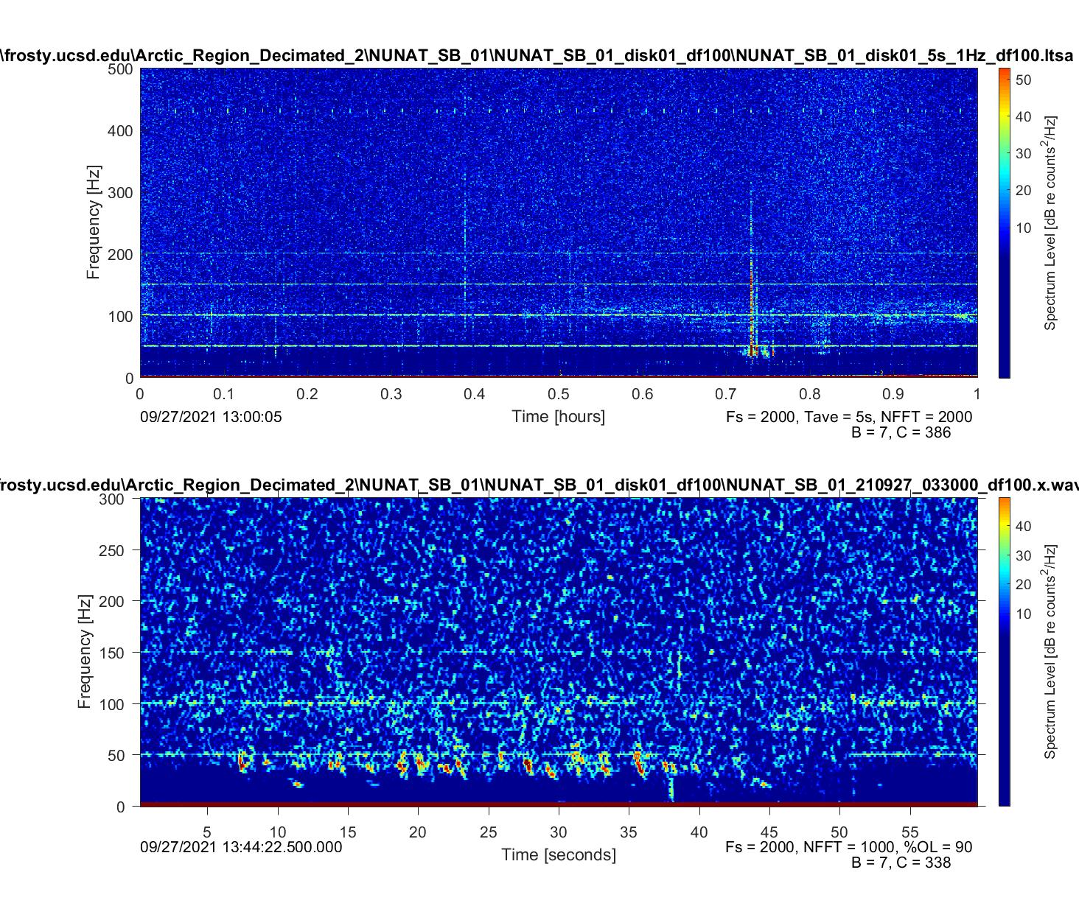
Bryde's whale pulse bout or minke whale pulse train?

Slide 28
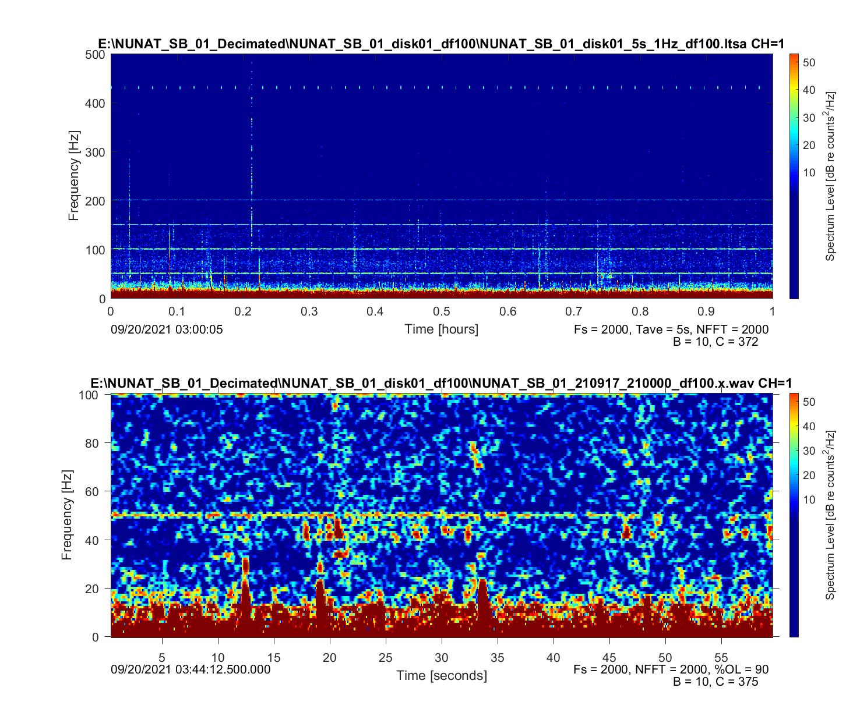

Slide 29
North Atlantic Right Whale
Most of these calls exist below 500 Hz with some vocalizations reaching 4000 Hz.
Up call
Duration: 2 s
This short “whoop” starts around 50Hz and ends around 450Hz.
Scream call
Duration: 0.5-3.0 s
These calls range in frequency from 400-3200 Hz
Gunshot call
Duration: 1 s
These quick, intense, gunshot-like sounds range in frequency from 0-1000 Hz
They function as a threat display to other males.

Slide 30
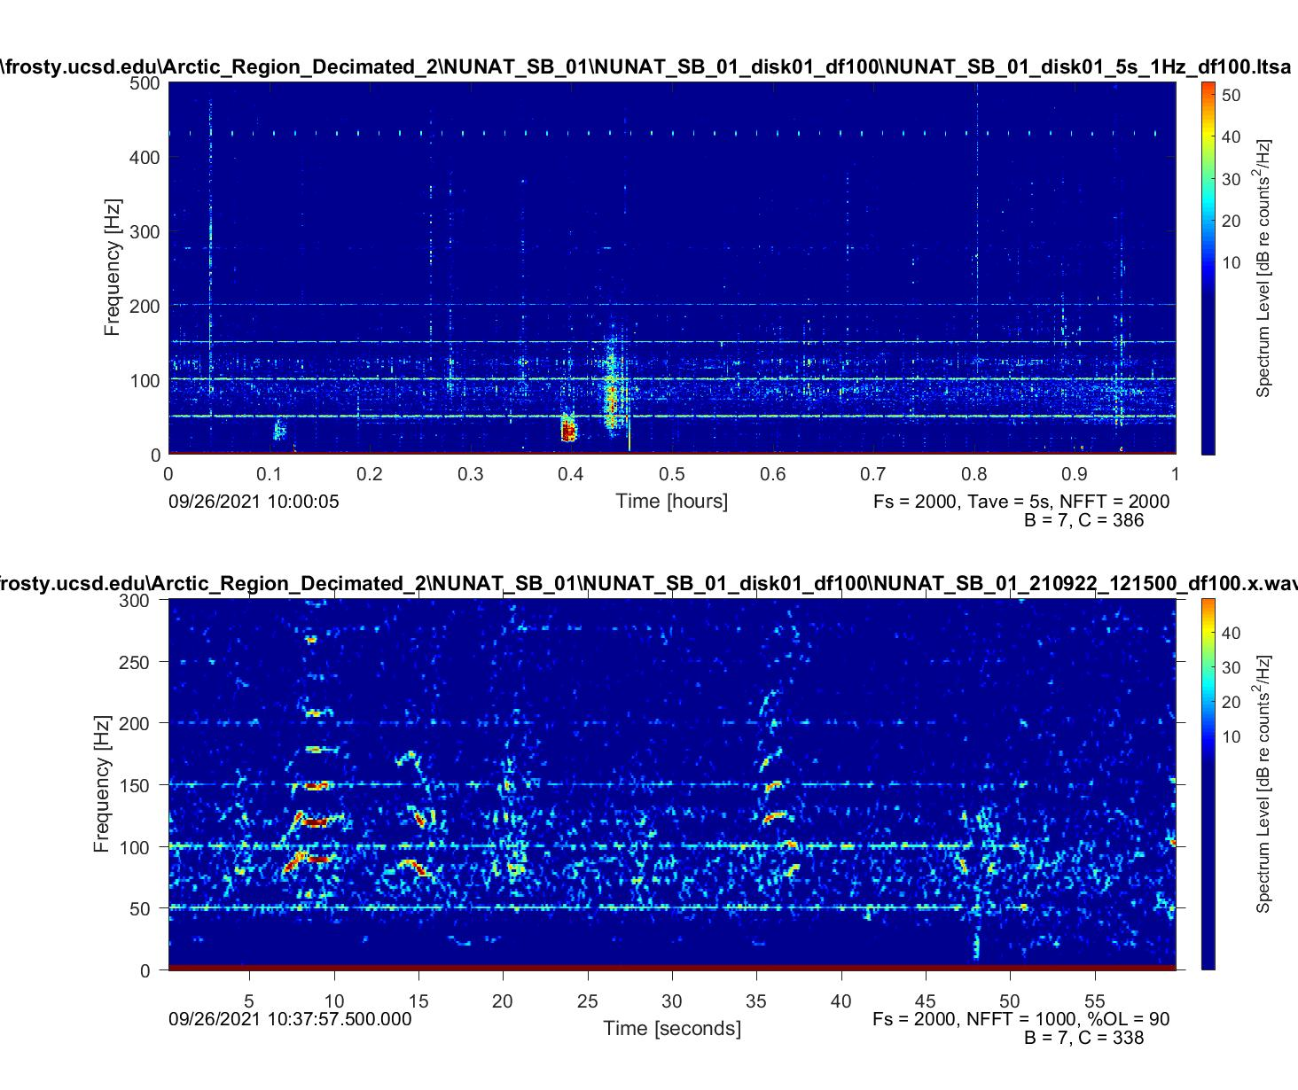
Scream call (banded)
Up call

Slide 31
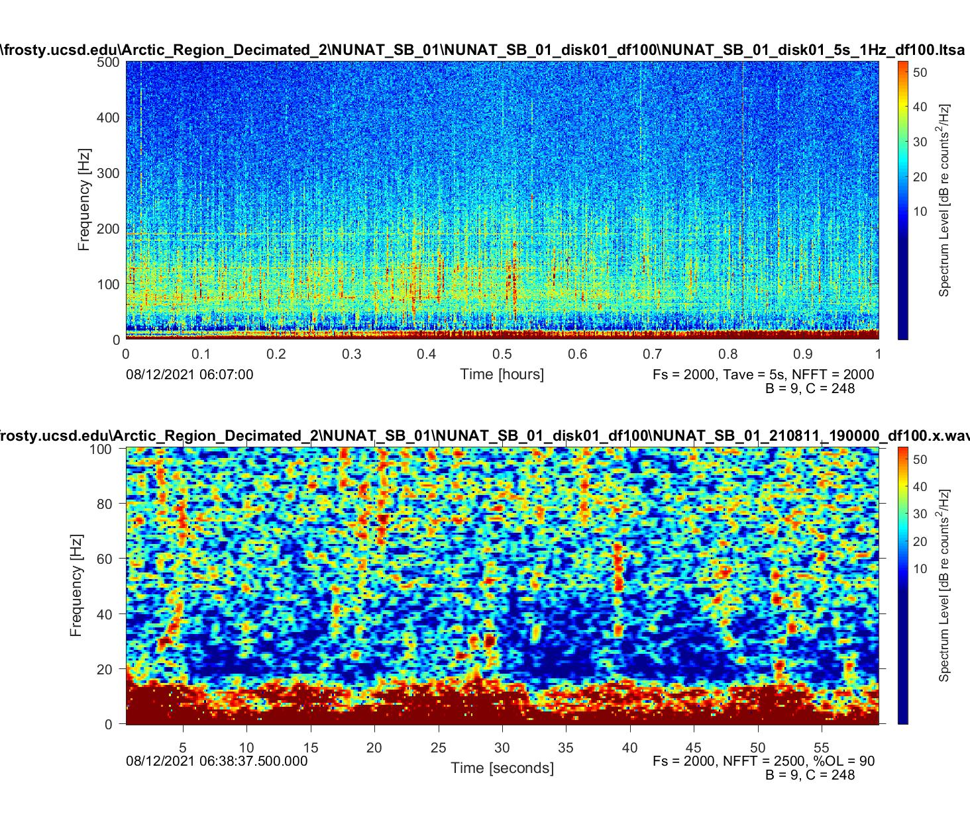
Up call

Slide 32
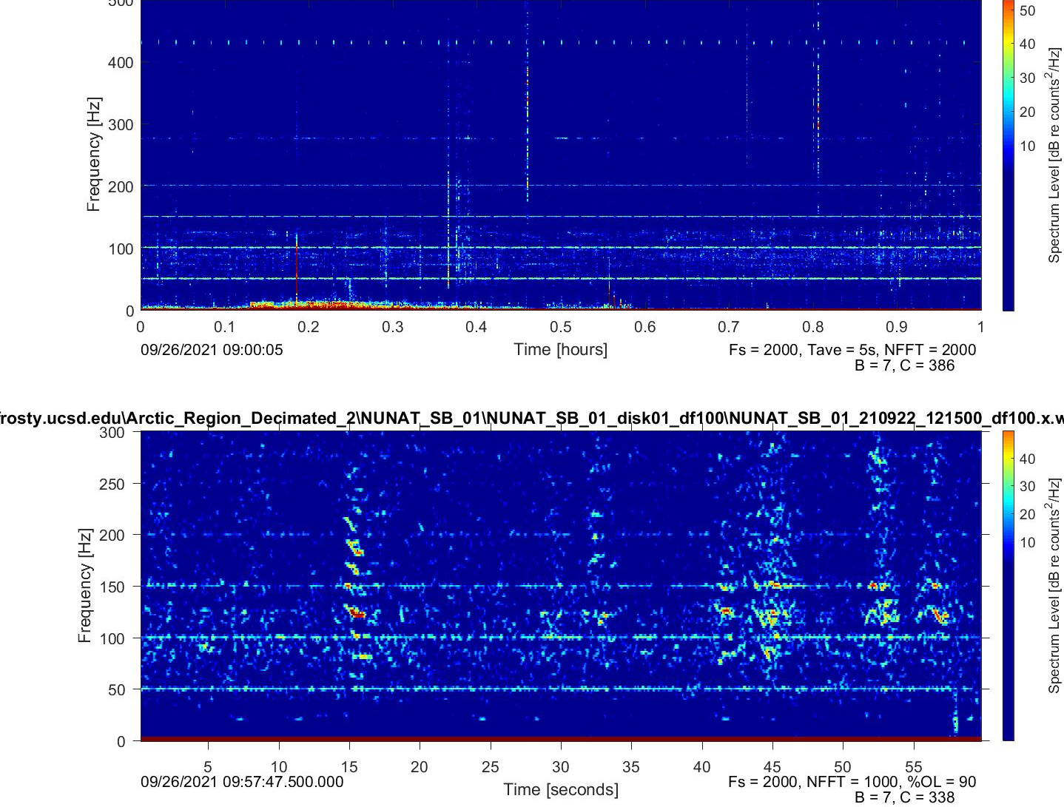

Slide 33
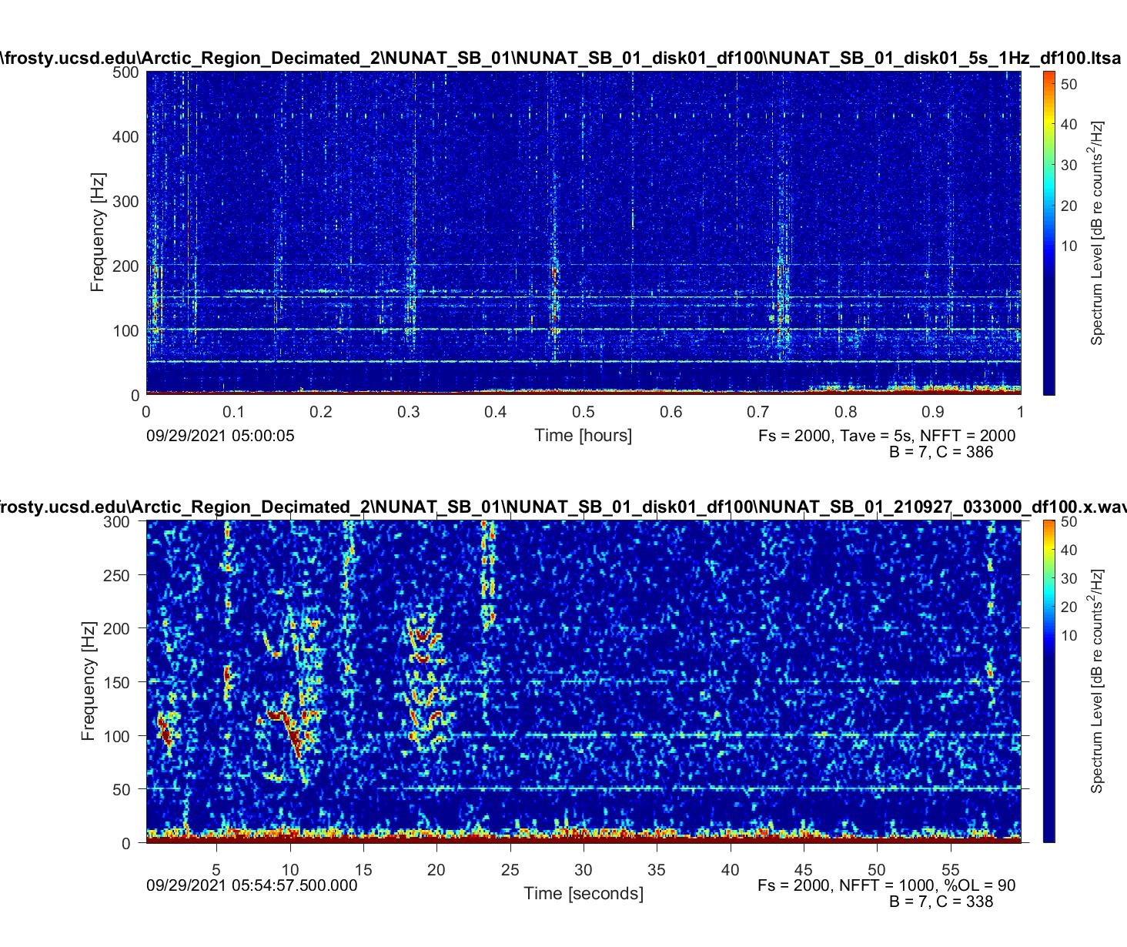

Slide 34
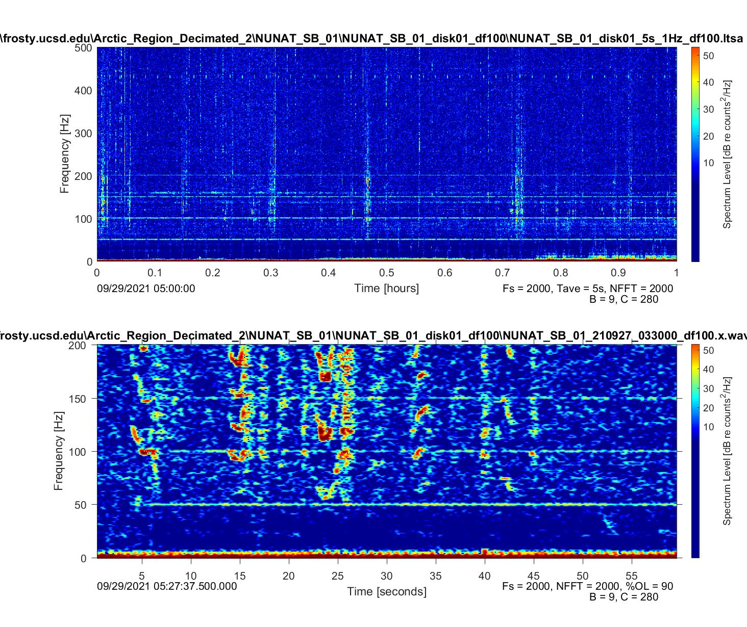

Slide 35
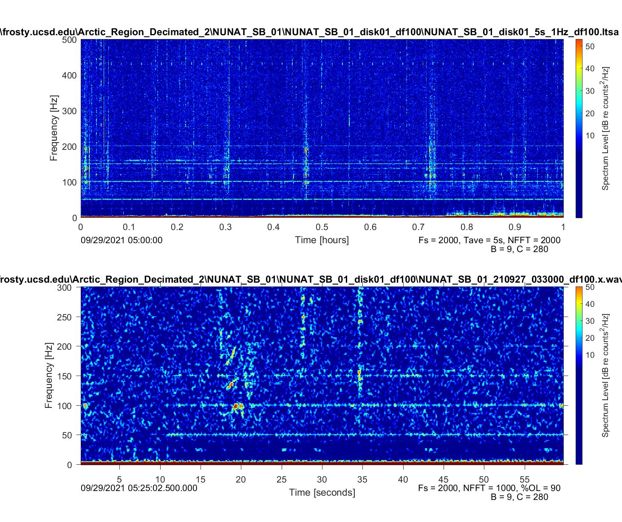

Slide 36
Blue Whale
North Atlantic A calls
Duration: 8 s
Constant frequency of around 20
North Atlantic B calls
Duration: 2-5 s
Downsweep with frequency ranging from 40-15Hz
Arch
Duration: 7 s
Call frequency range: 70-30 Hz (very variable)
Units are combined into phrases which are repeated to form a song.
North Atlantic blue whale songs were first described as consisting of a single tonal unit near 19Hz
Shal et al 2019: blue whale downsweeps range from 80-30Hz (D calls) duration: 1.8(0.6-4.1s)

Slide 37
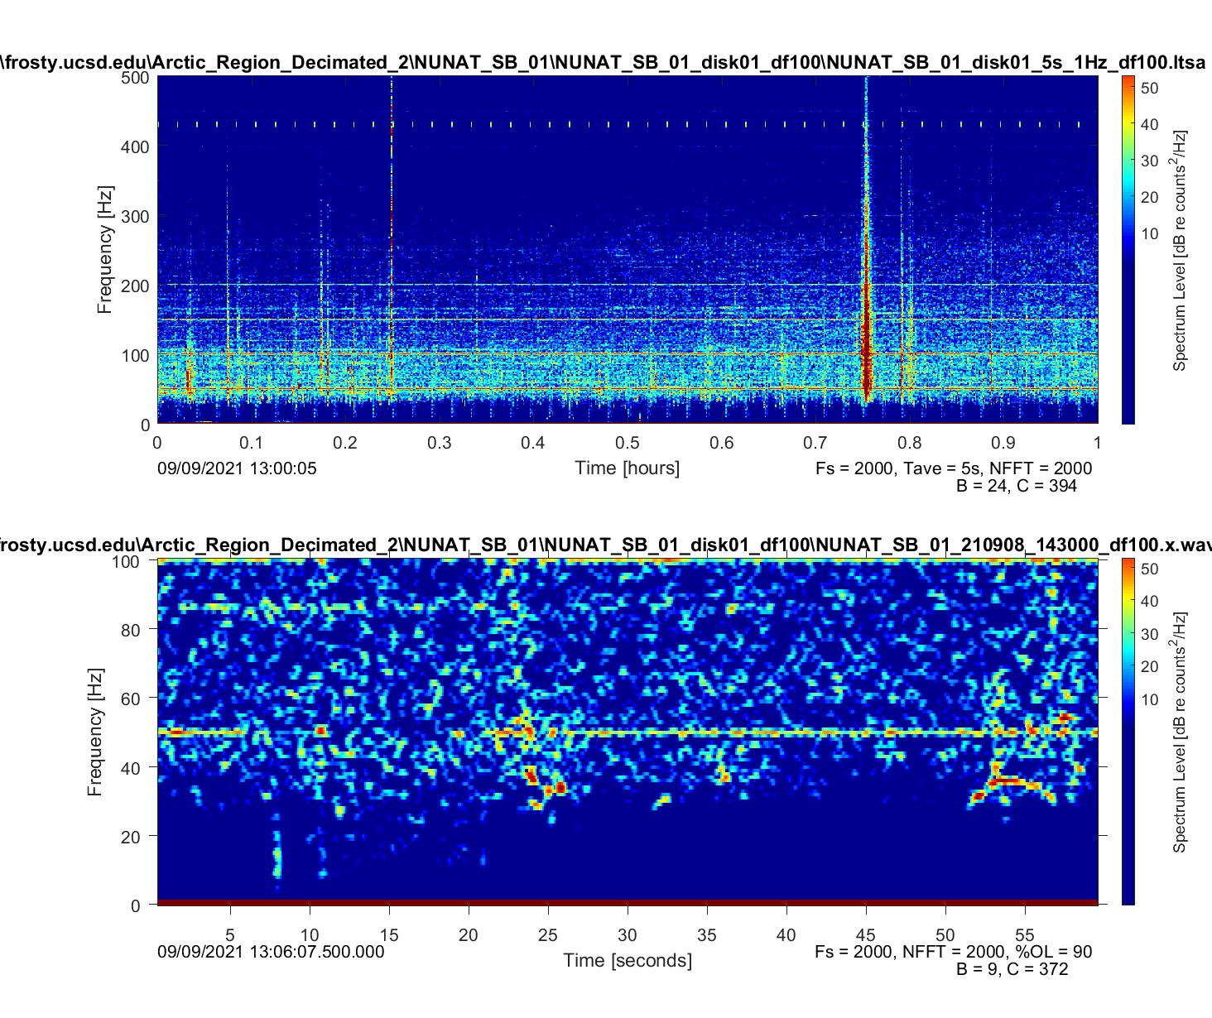
Arch

Slide 38
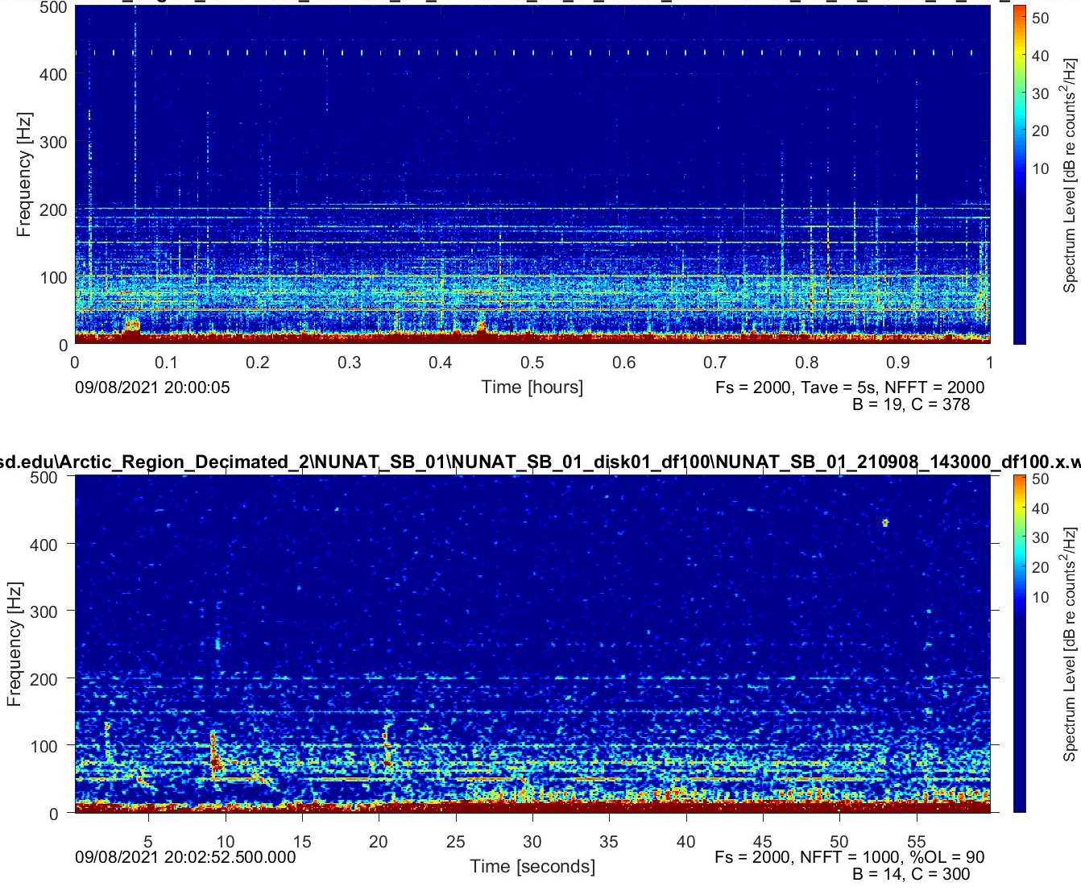
North Atlantic A call followed by a B call

Slide 39
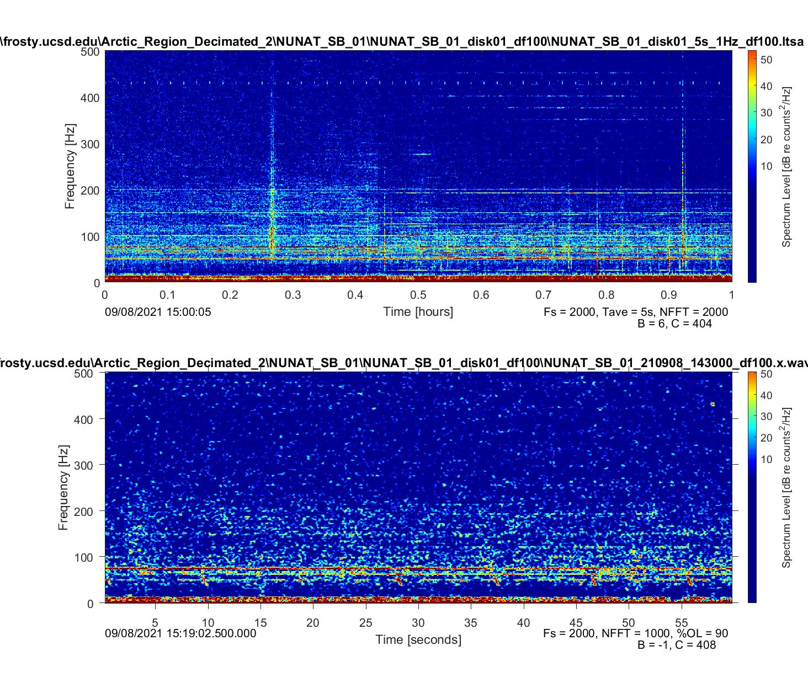

Slide 40
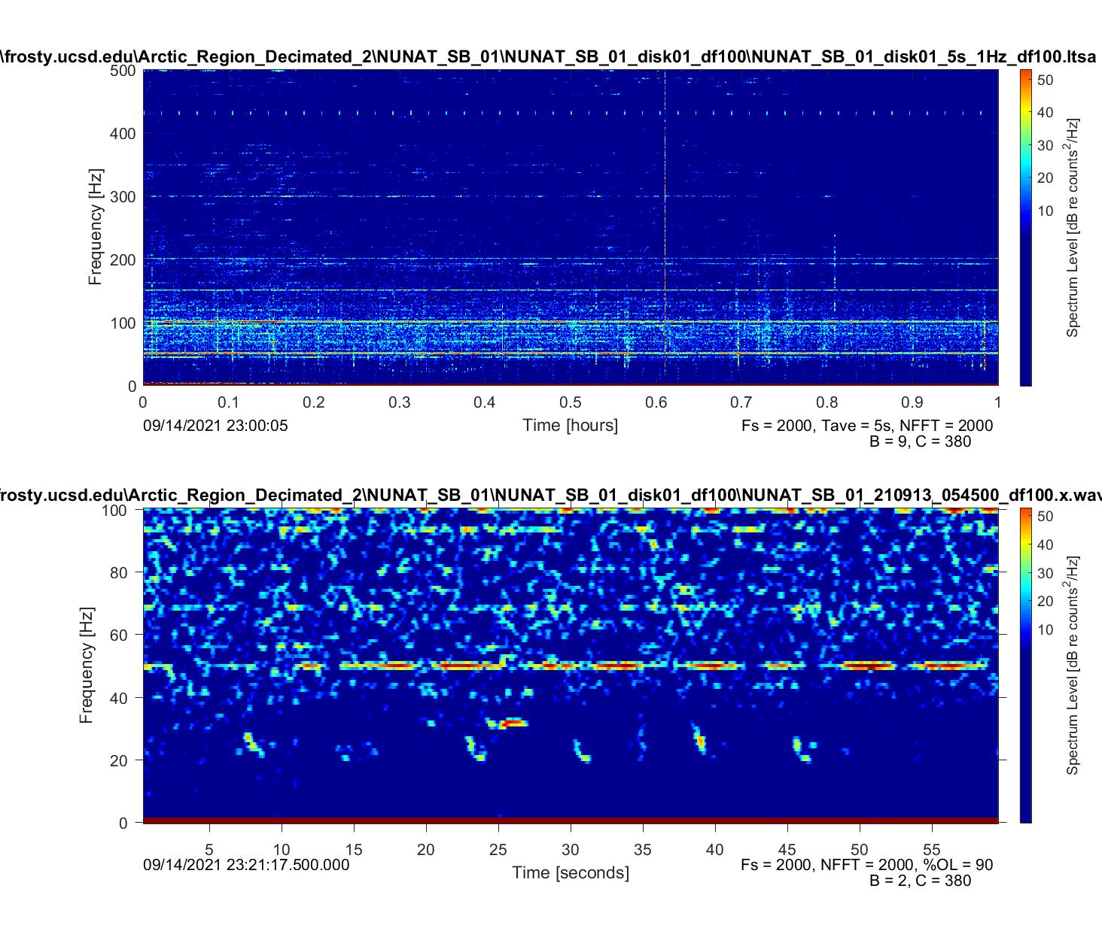

Slide 41
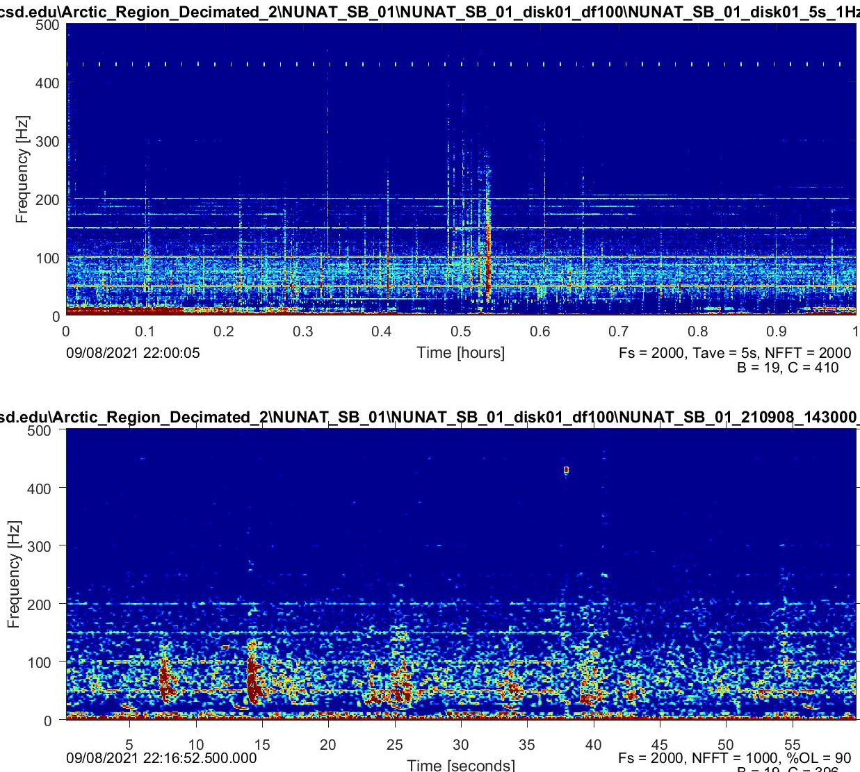

Slide 42
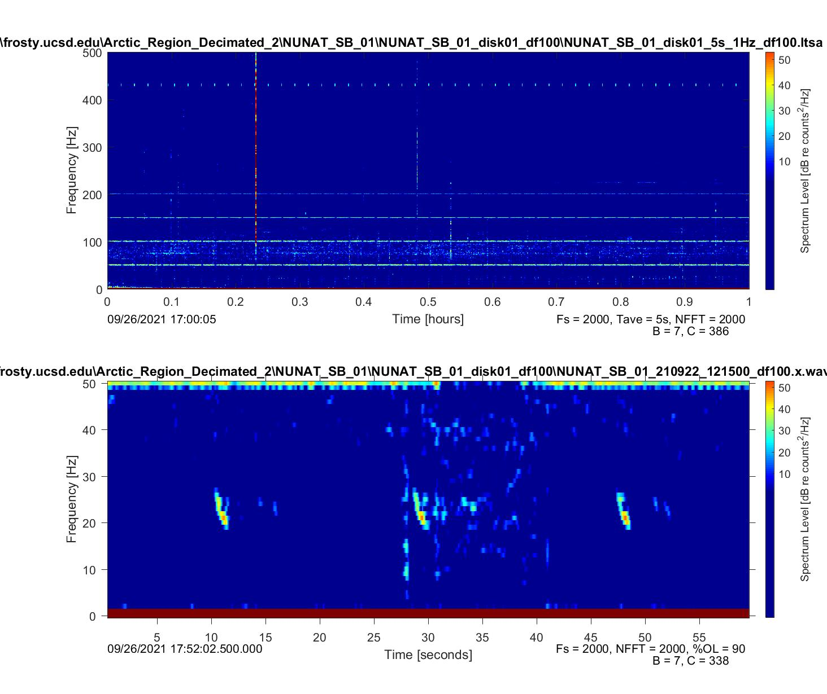
B call

Slide 43
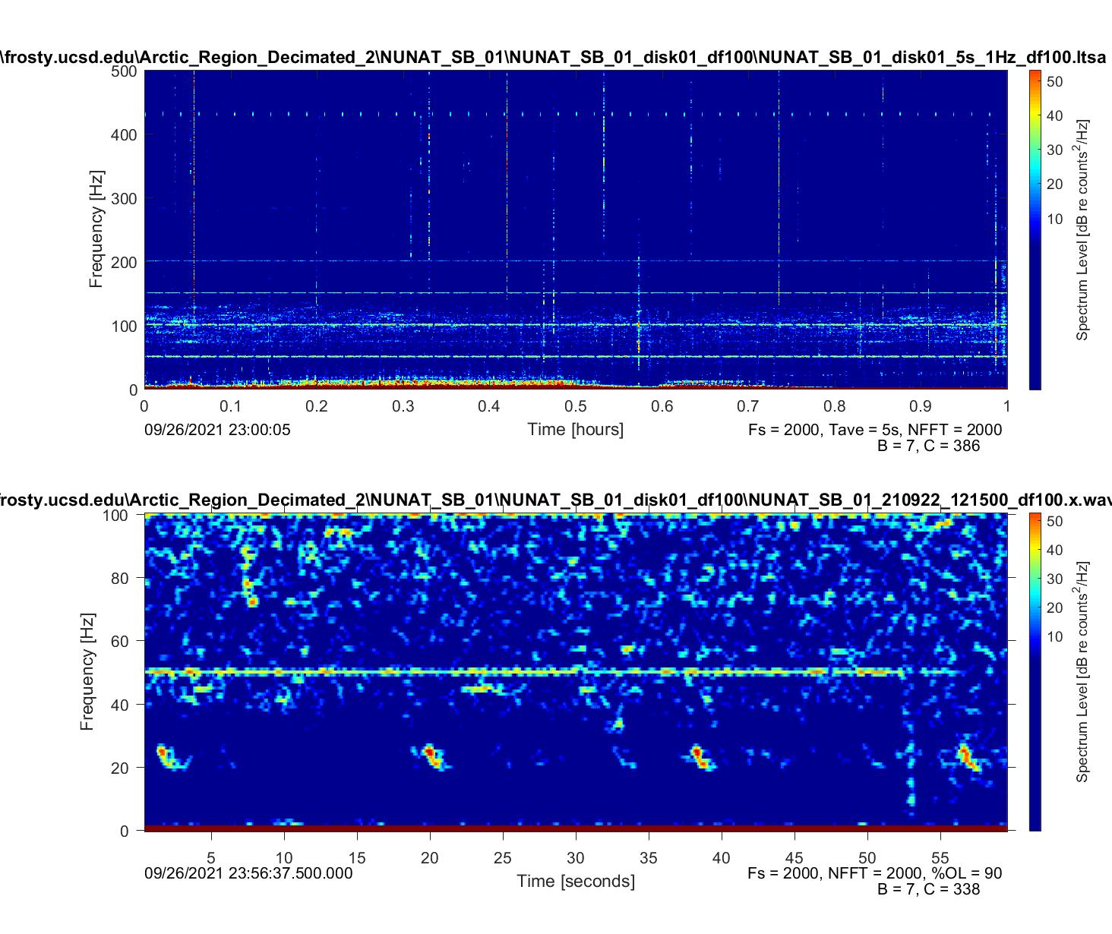

Slide 44
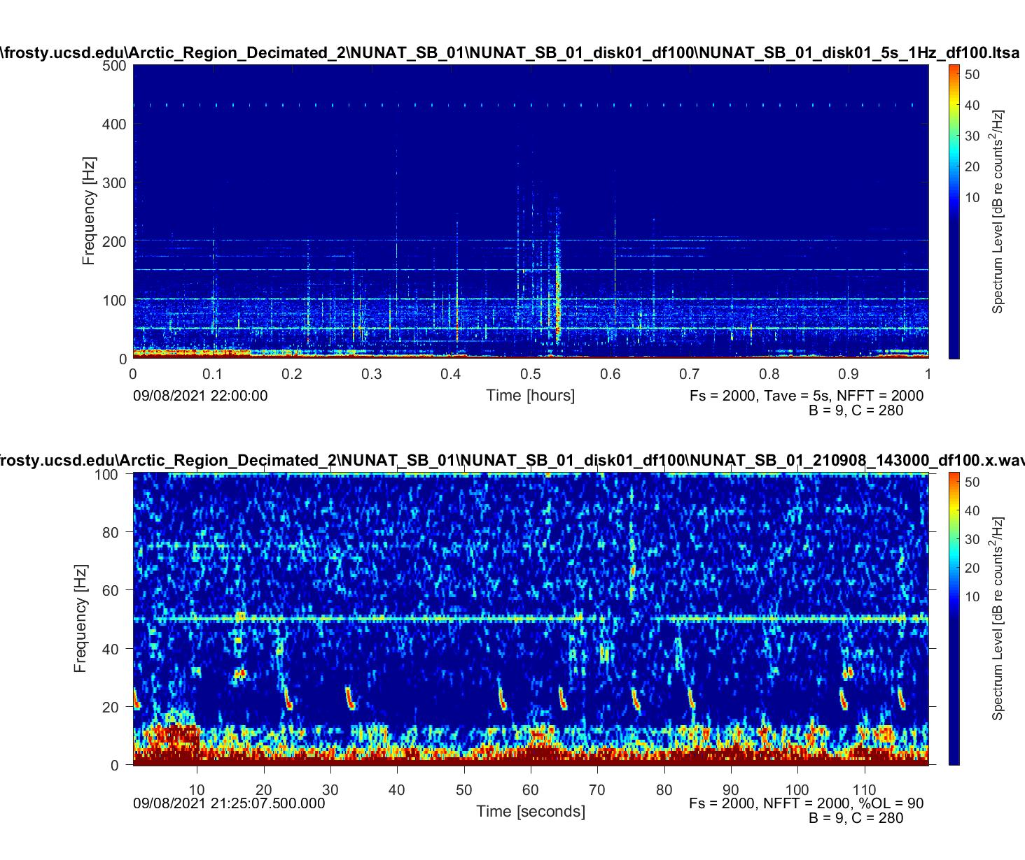

Slide 45
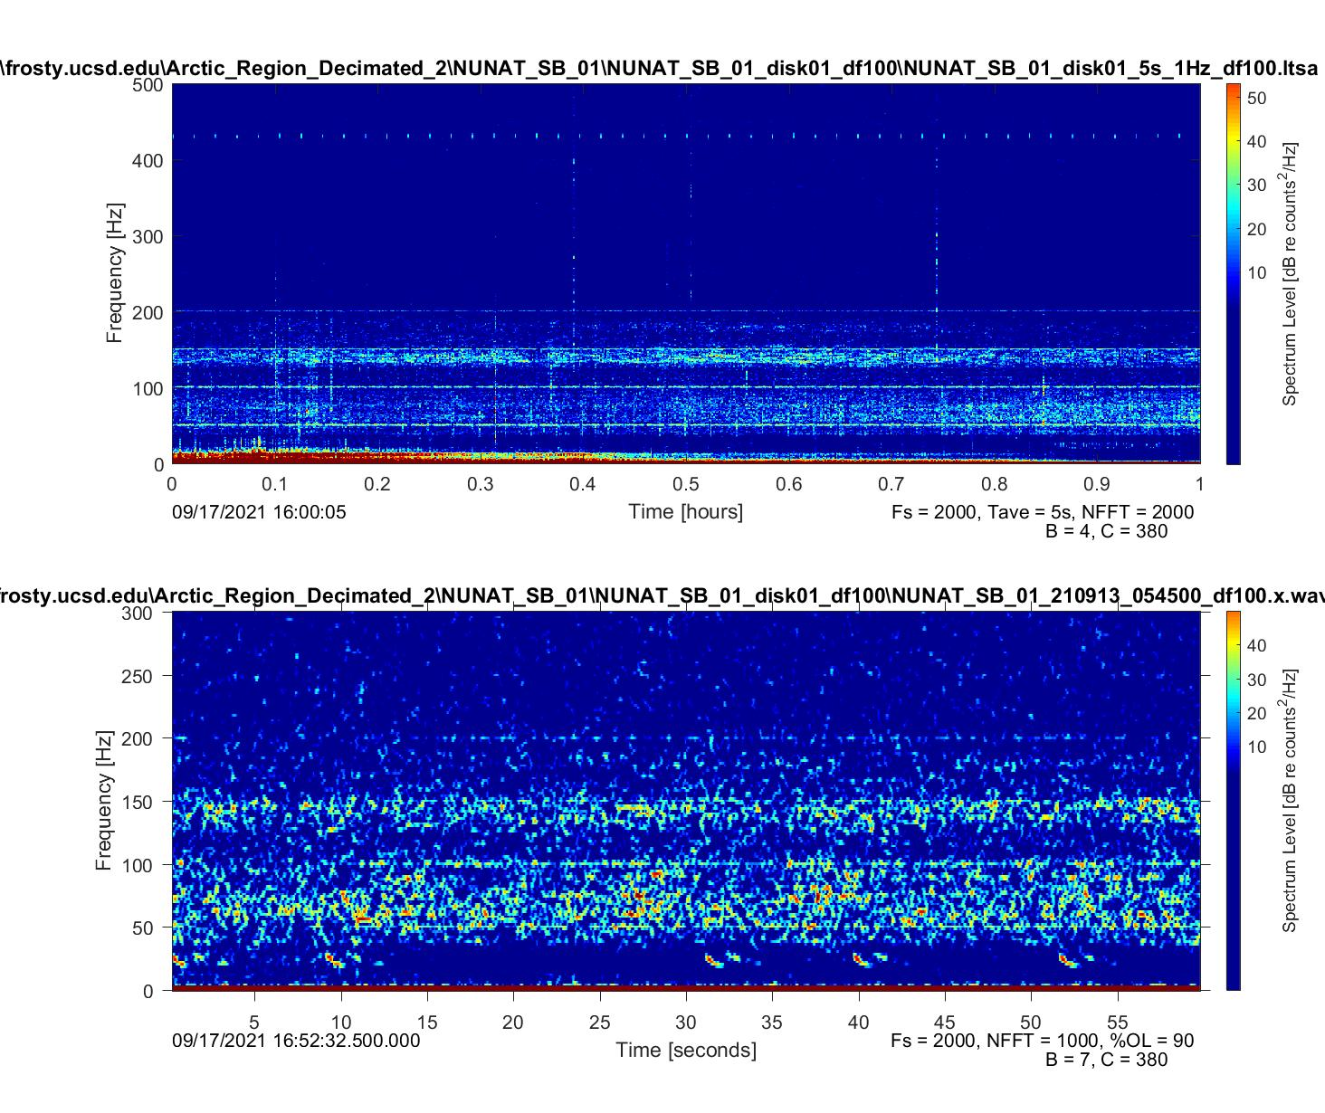

Slide 46
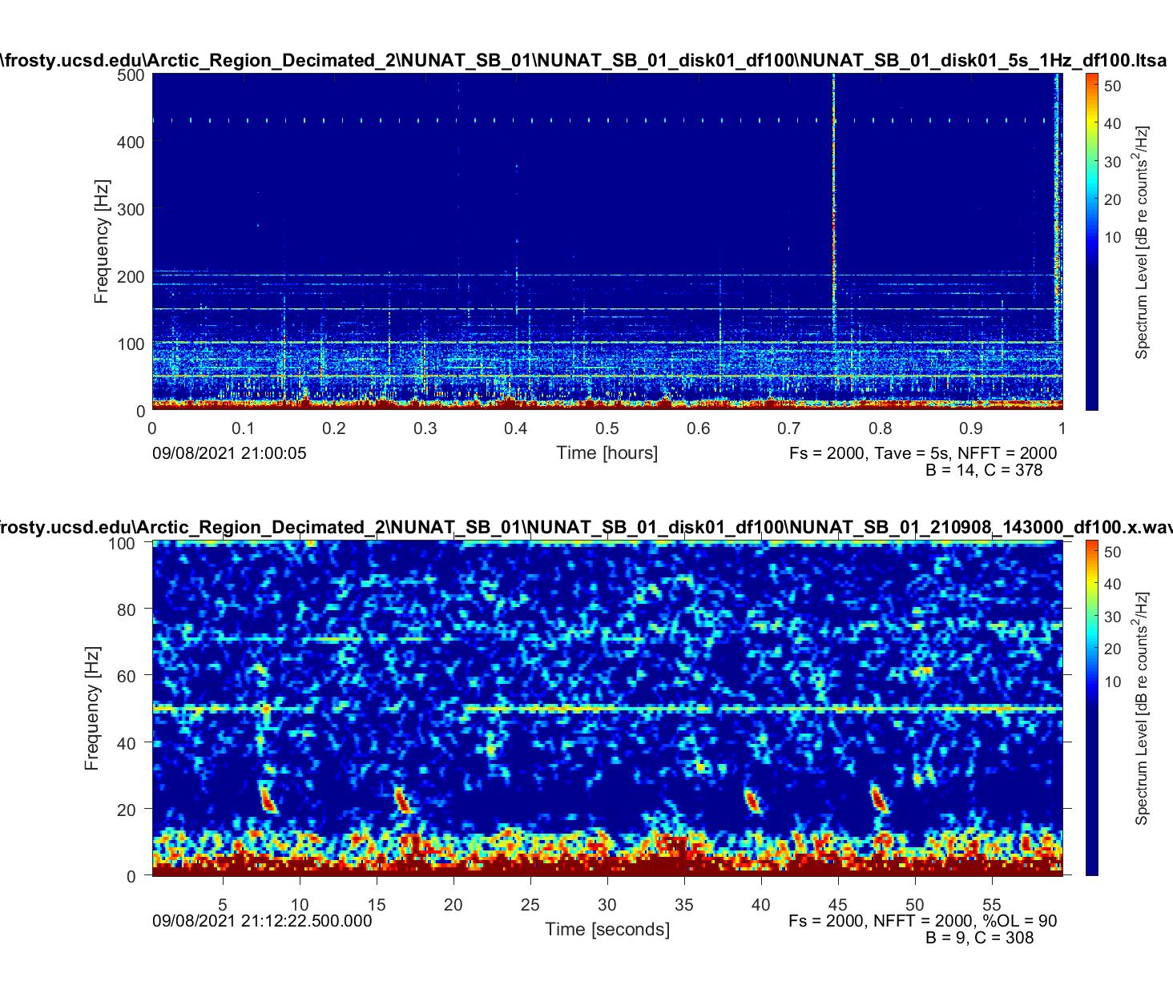

Slide 47
Unidentified

Slide 48
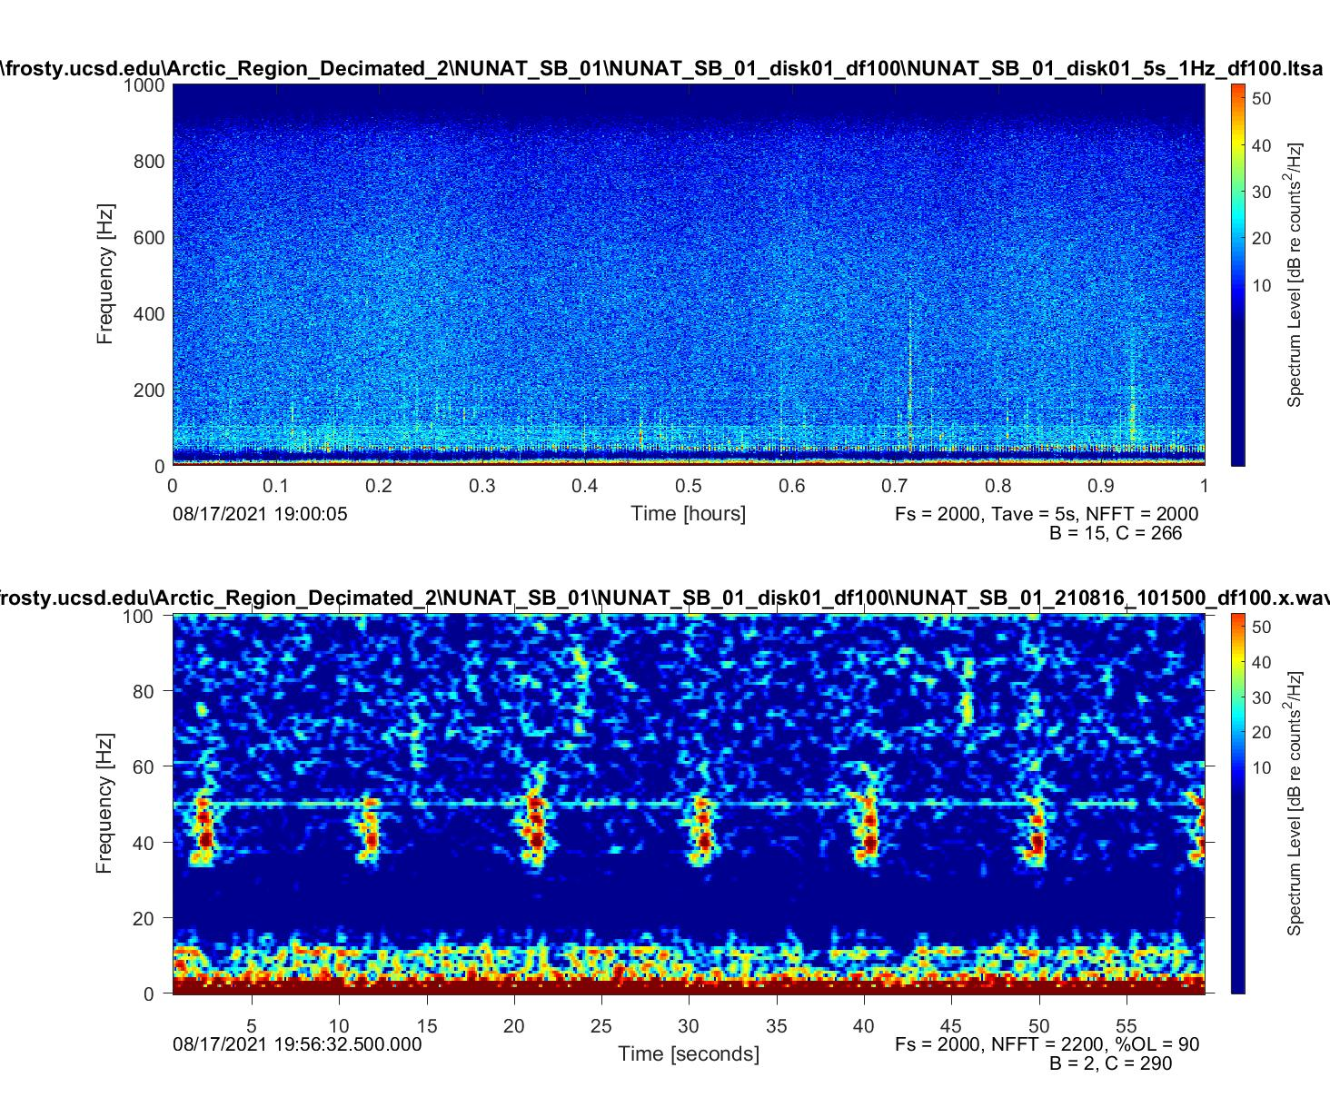
Seismic survey

Slide 49
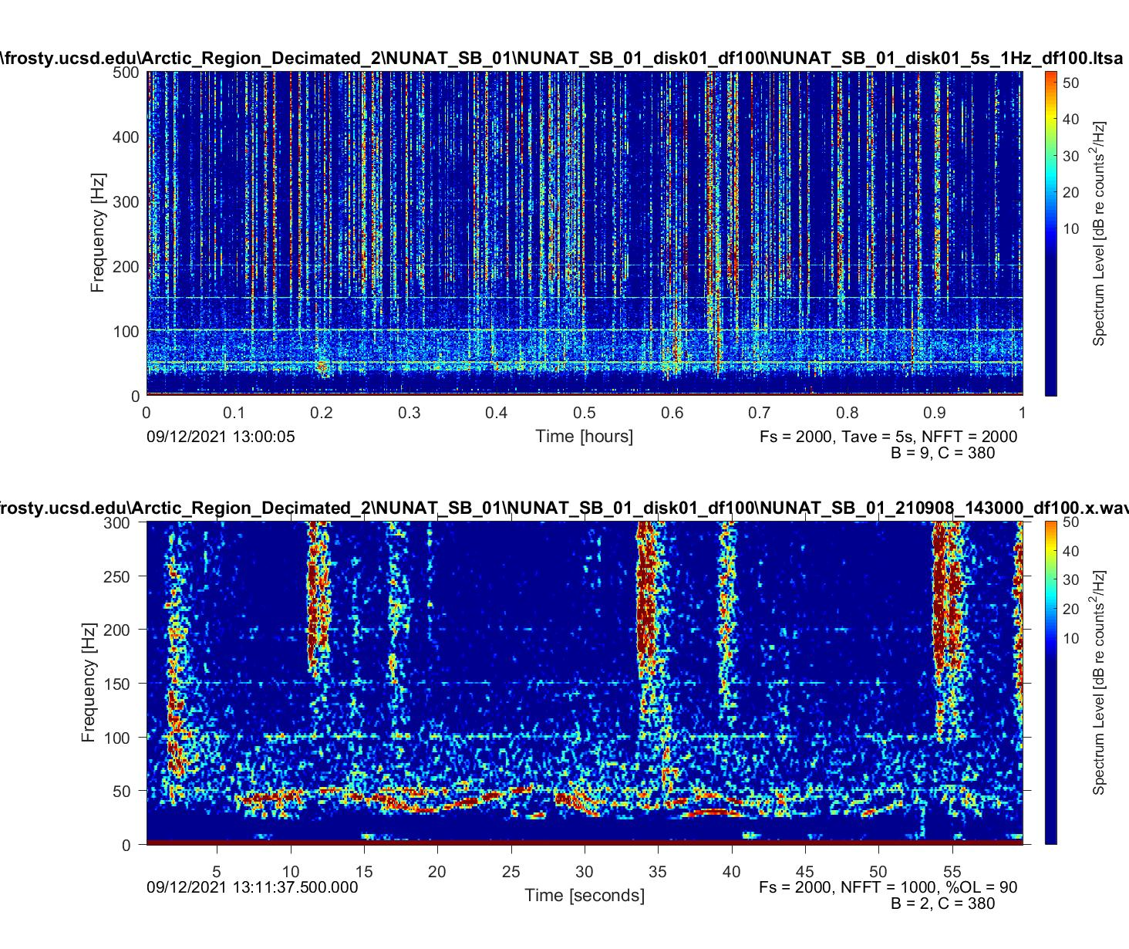

Slide 50
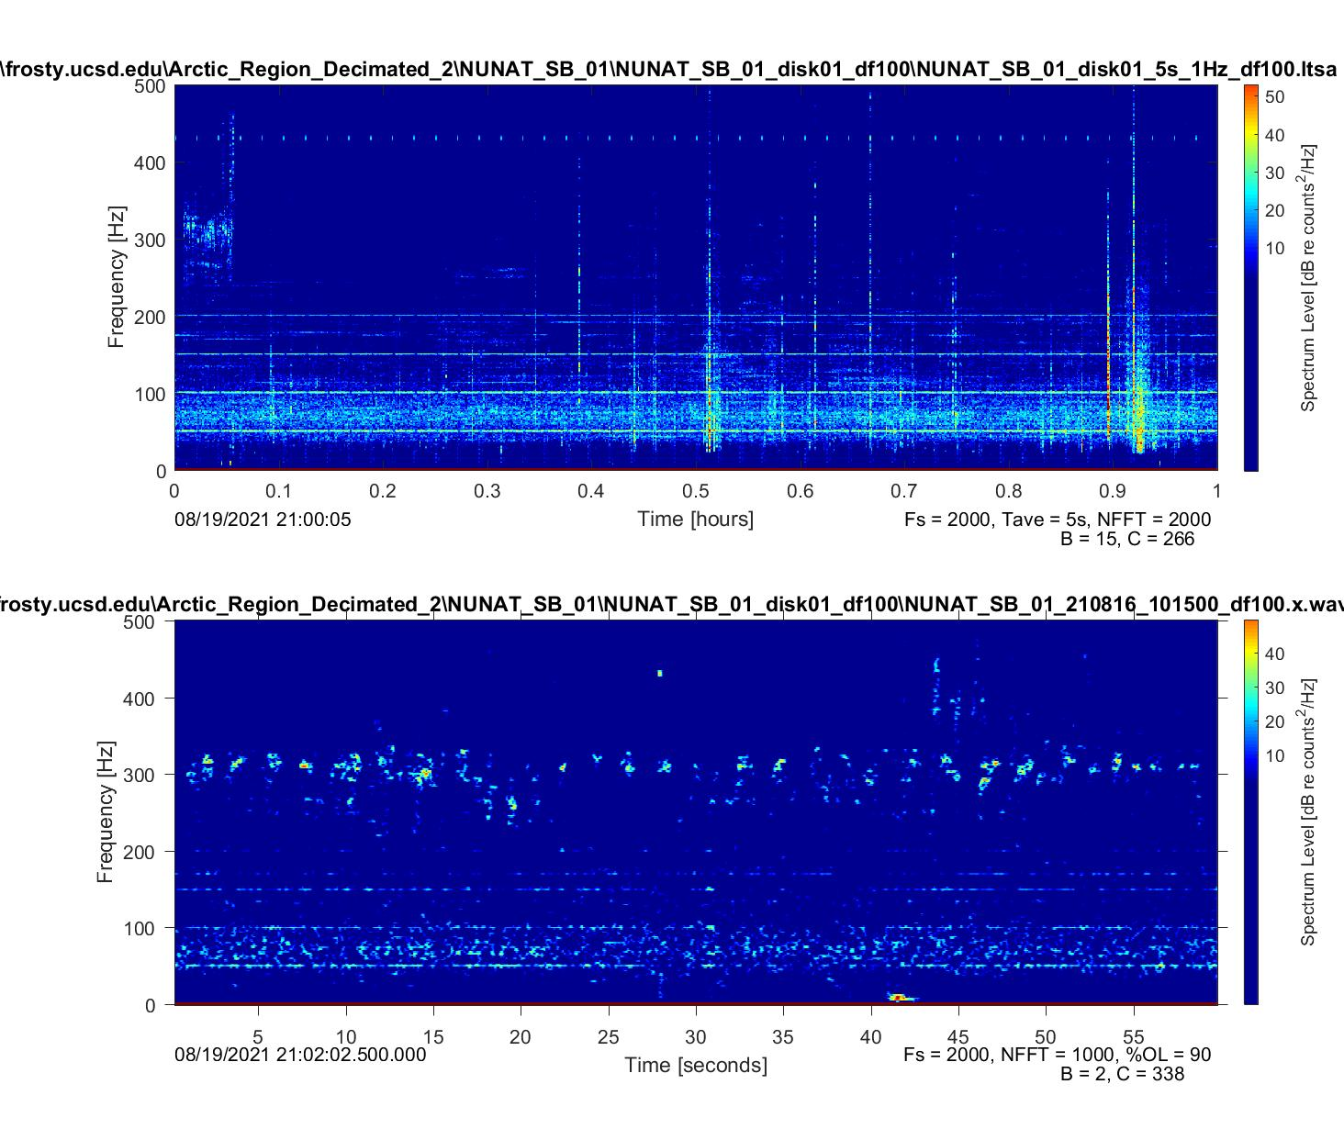

Slide 51
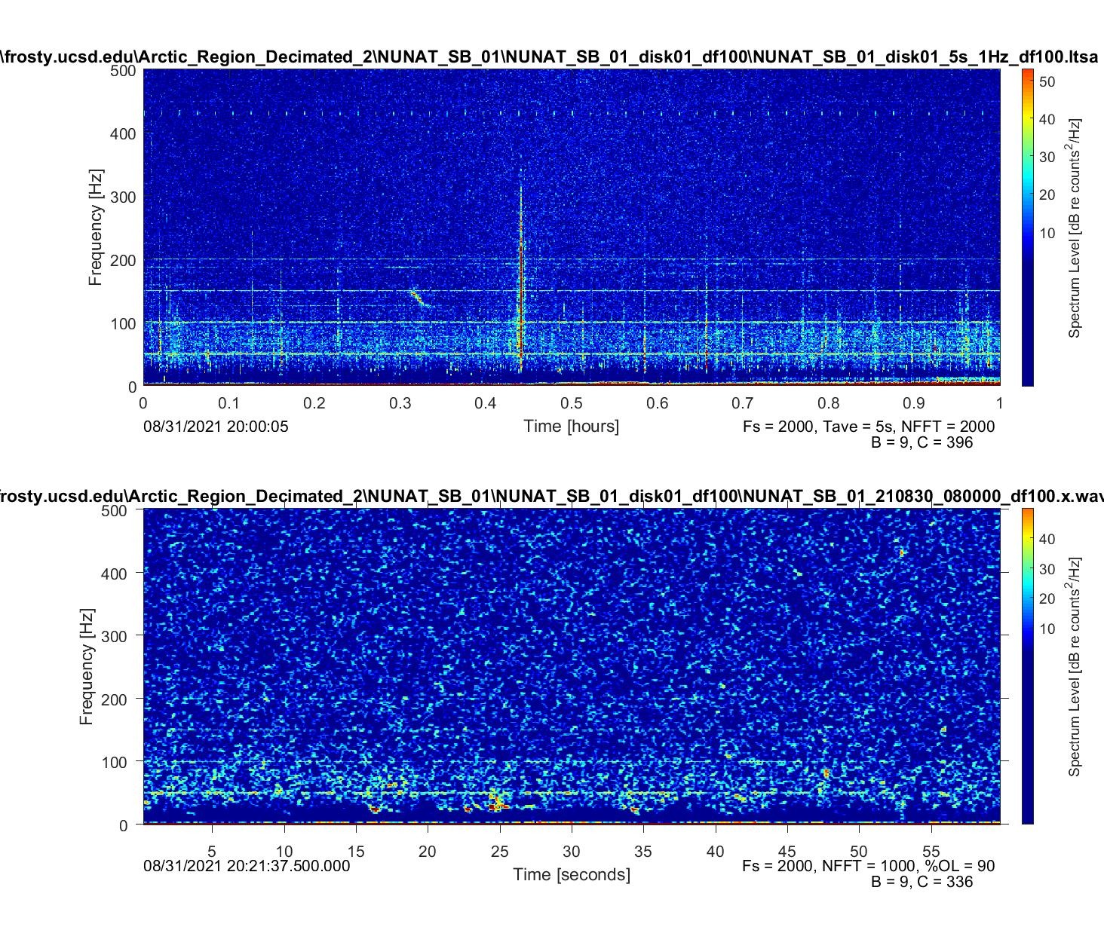

Slide 52
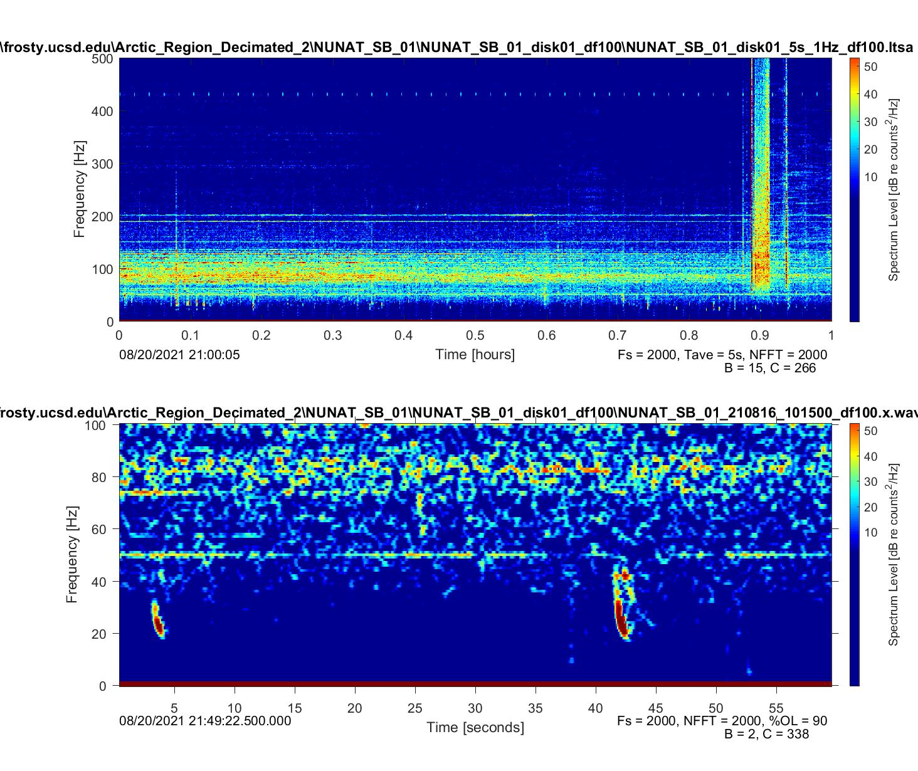

Slide 53
